Slide 1
Parametric and Non Parametric methods for missing value imputation in observational studies - Kirtikanth Kalapatapu

Slide 2
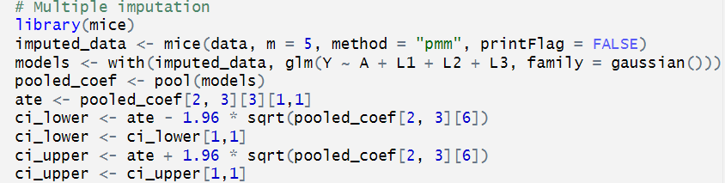
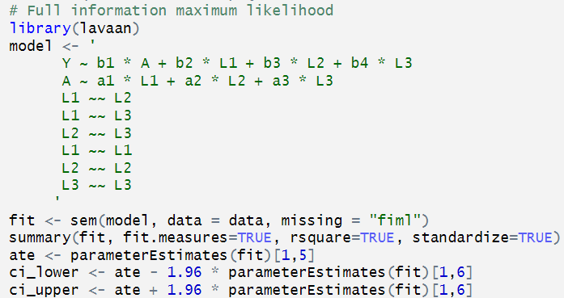
Parametric Imputation methods
Multiple Imputation (MI):
Creates multiple complete datasets by imputing missing values based on observed data
Analyzes each imputed dataset separately and combines results to account for uncertainty
Requires specifying an imputation model and can handle various types of missing data.
Full Information Maximum Likelihood (FIML):
Estimates model parameters directly using all available information from observed data
Assumes missing data are Missing at Random (MAR) or Missing Completely at Random (MCAR)
Provides unbiased estimates and standard errors when assumptions are met
Typically more efficient than MI, especially with large amounts of missing data

Slide 3
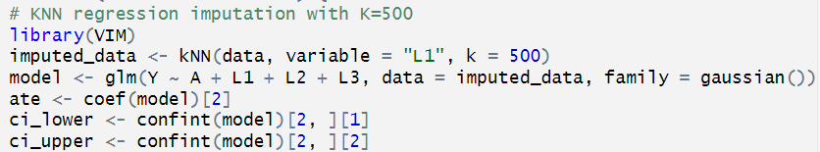
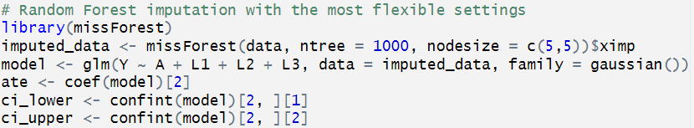
Non- Parametric Imputation methods
K-Nearest Neighbors (KNN) Imputation:
Imputes missing values based on the values of the k-nearest neighbors in the feature space
Distance metrics (e.g., Euclidean, Manhattan) are used to determine the nearest neighbors
The imputed value is typically the mean (for continuous variables) or mode (for categorical variables) of the k-nearest neighbors
The choice of k and the distance metric can affect the imputation results
Random Forest (RF) Imputation
Builds multiple decision trees using bootstrap samples of the data
Each tree is constructed using a random subset of features at each split
Missing values are imputed based on the predictions of the trained random forest model
Can handle both continuous and categorical variables
Captures complex relationships and interactions among variables
Provides robust imputations by averaging predictions from multiple trees

Slide 4
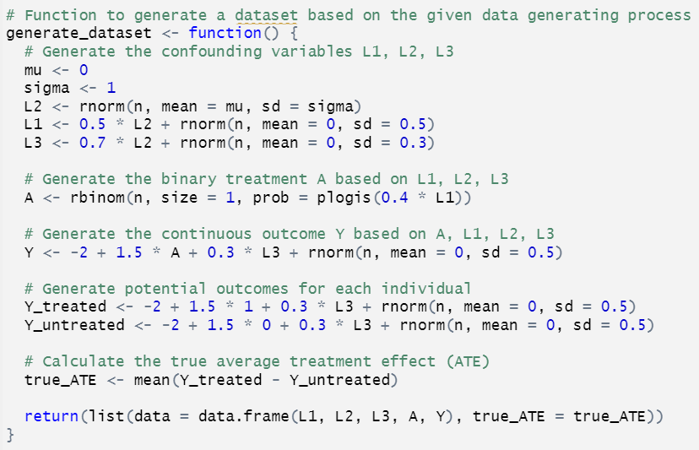
Scenario 1 – Simple DAG, Binary Treatment, Continous Outcome
MCAR (Missing Completely at Random):
A study is conducted to investigate the effectiveness of a new weight loss medication (treatment A) on patients with obesity. The confounders are physical activity level (L1), socioeconomic status (L2), and diet quality (L3). The outcome (Y) is the change in body weight after treatment.
P(R_L1 = 1 | A, L1, L2, L3, Y) = P(R_L1 = 1) Where R_L1 = 1 indicates missing data
L2
L1
L3
A
Y
MNAR (Missing not at Random):
A study is conducted to evaluate the effectiveness of a new antidepressant medication (treatment A) on patients with major depressive disorder (MDD). The confounders are the severity of depression symptoms at baseline (L1), duration of MDD (L2), and presence of co-occurring anxiety disorders (L3). The outcome (Y) is the reduction in depression symptoms after treatment.
P(L1_missing | l1_observed) = pnorm(l1_observed)

Slide 5
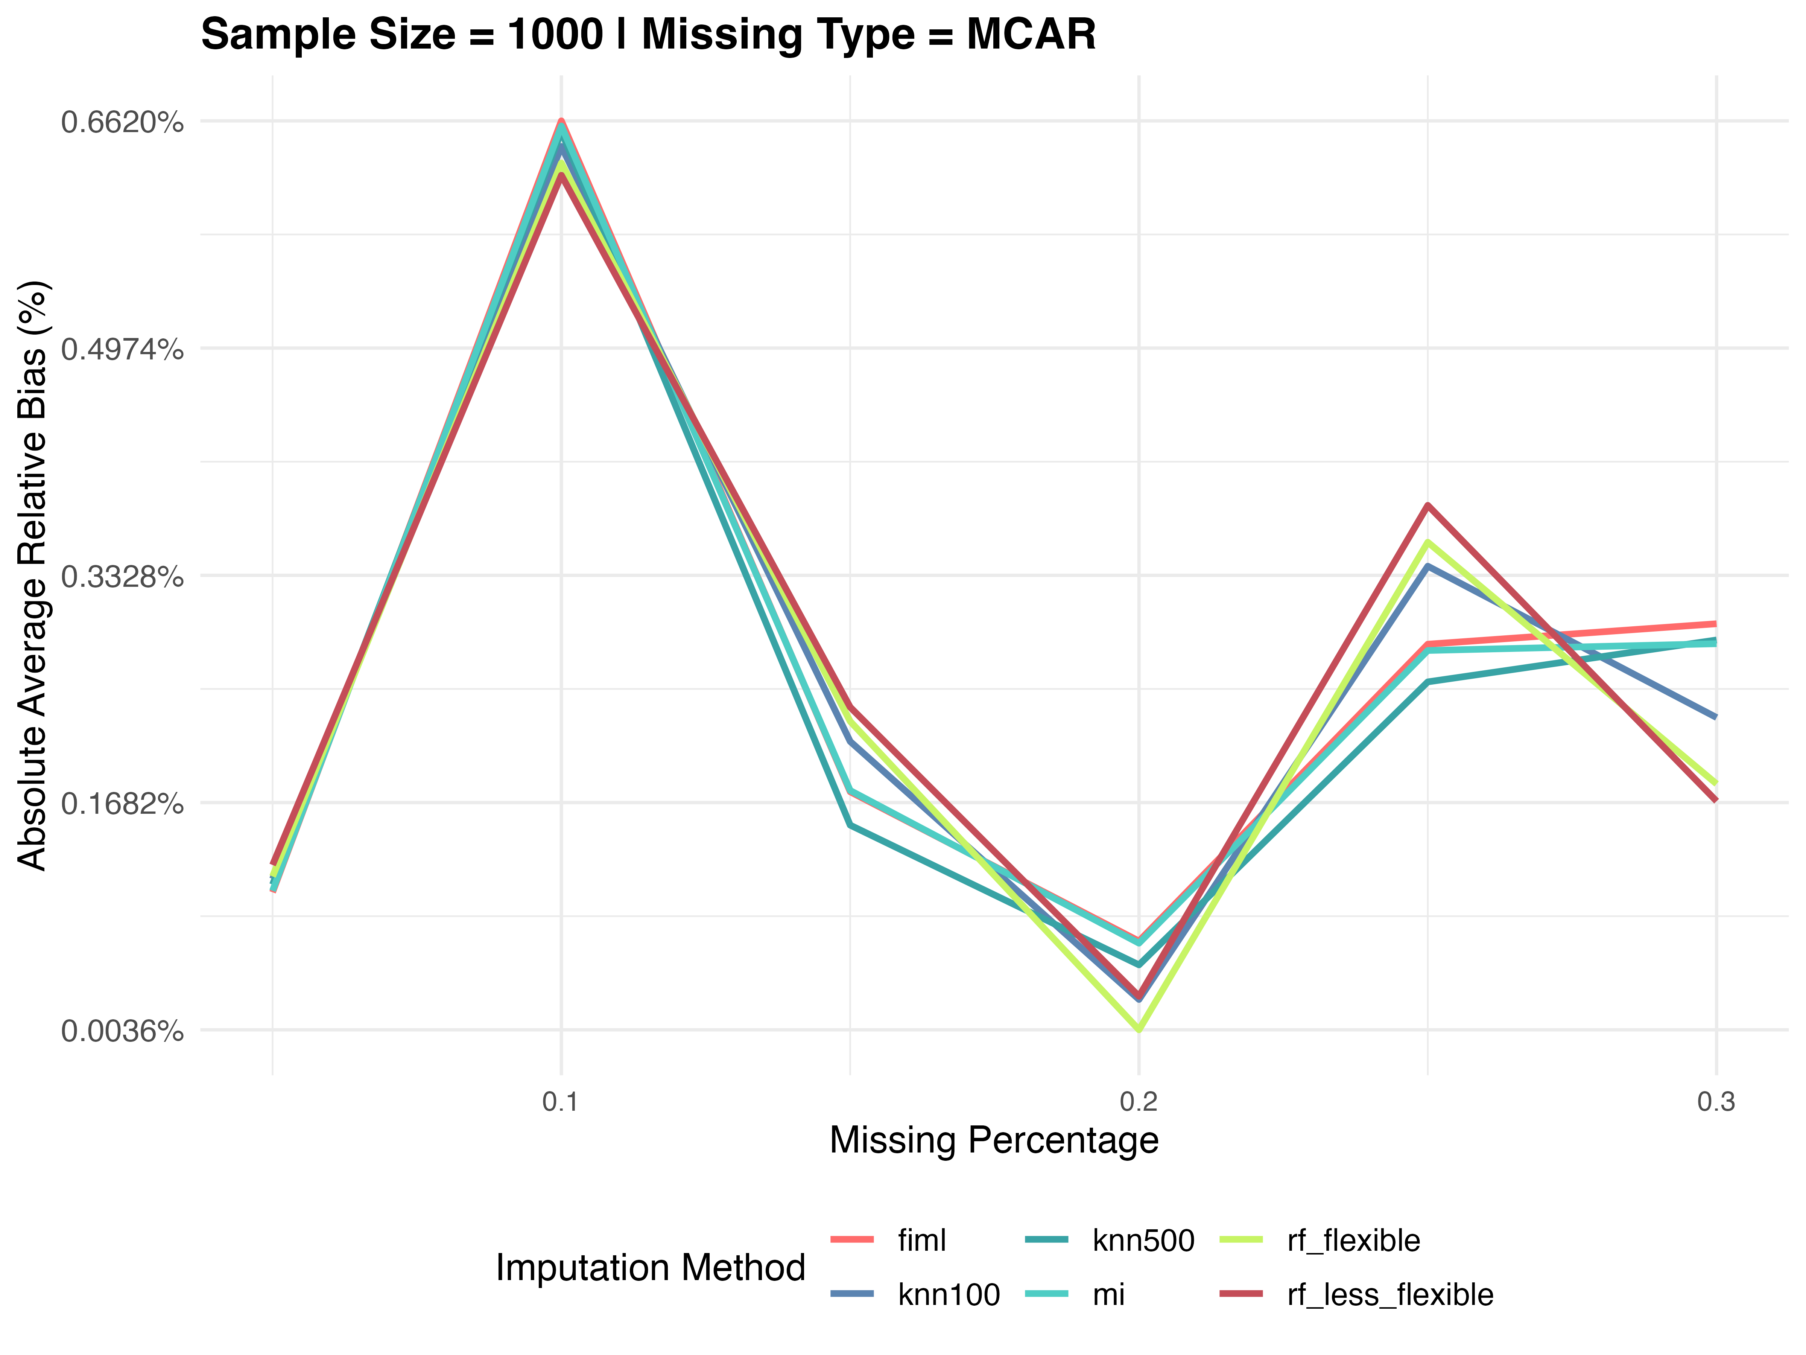
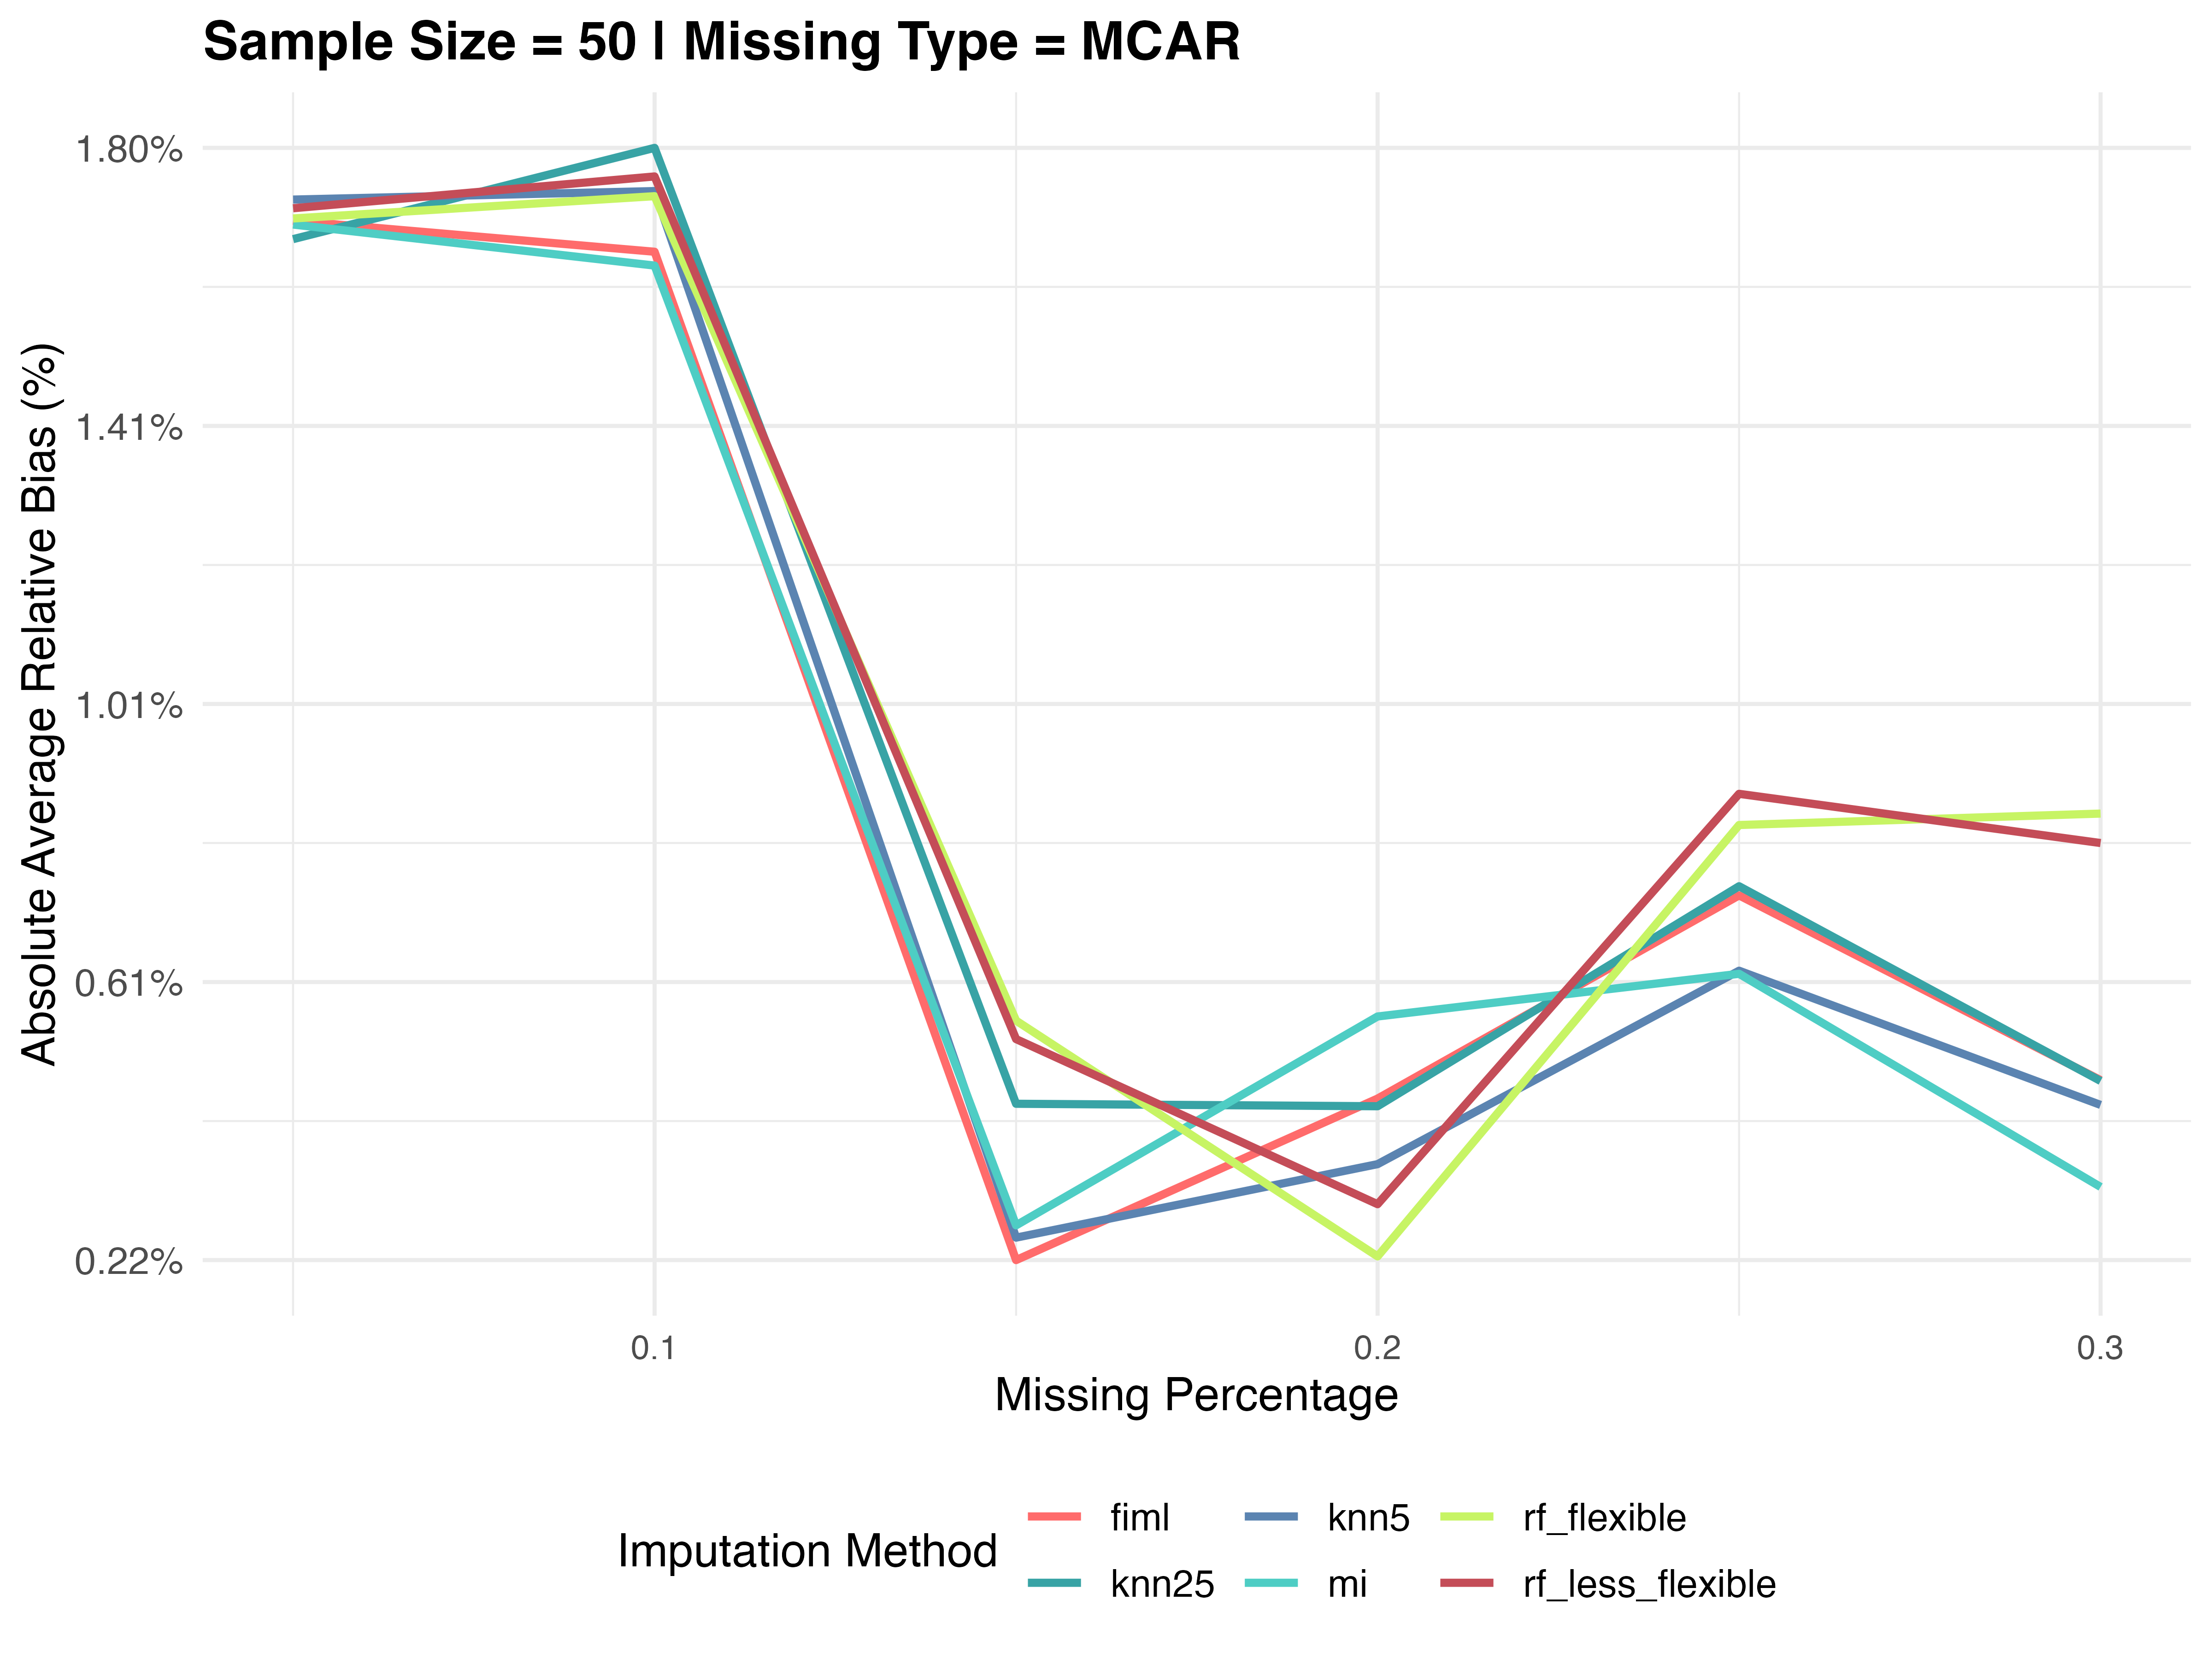
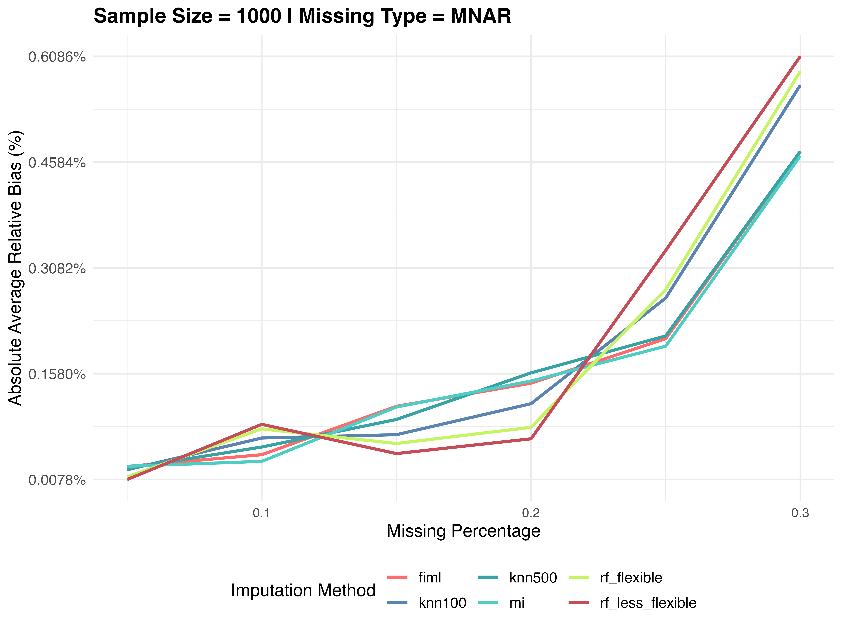
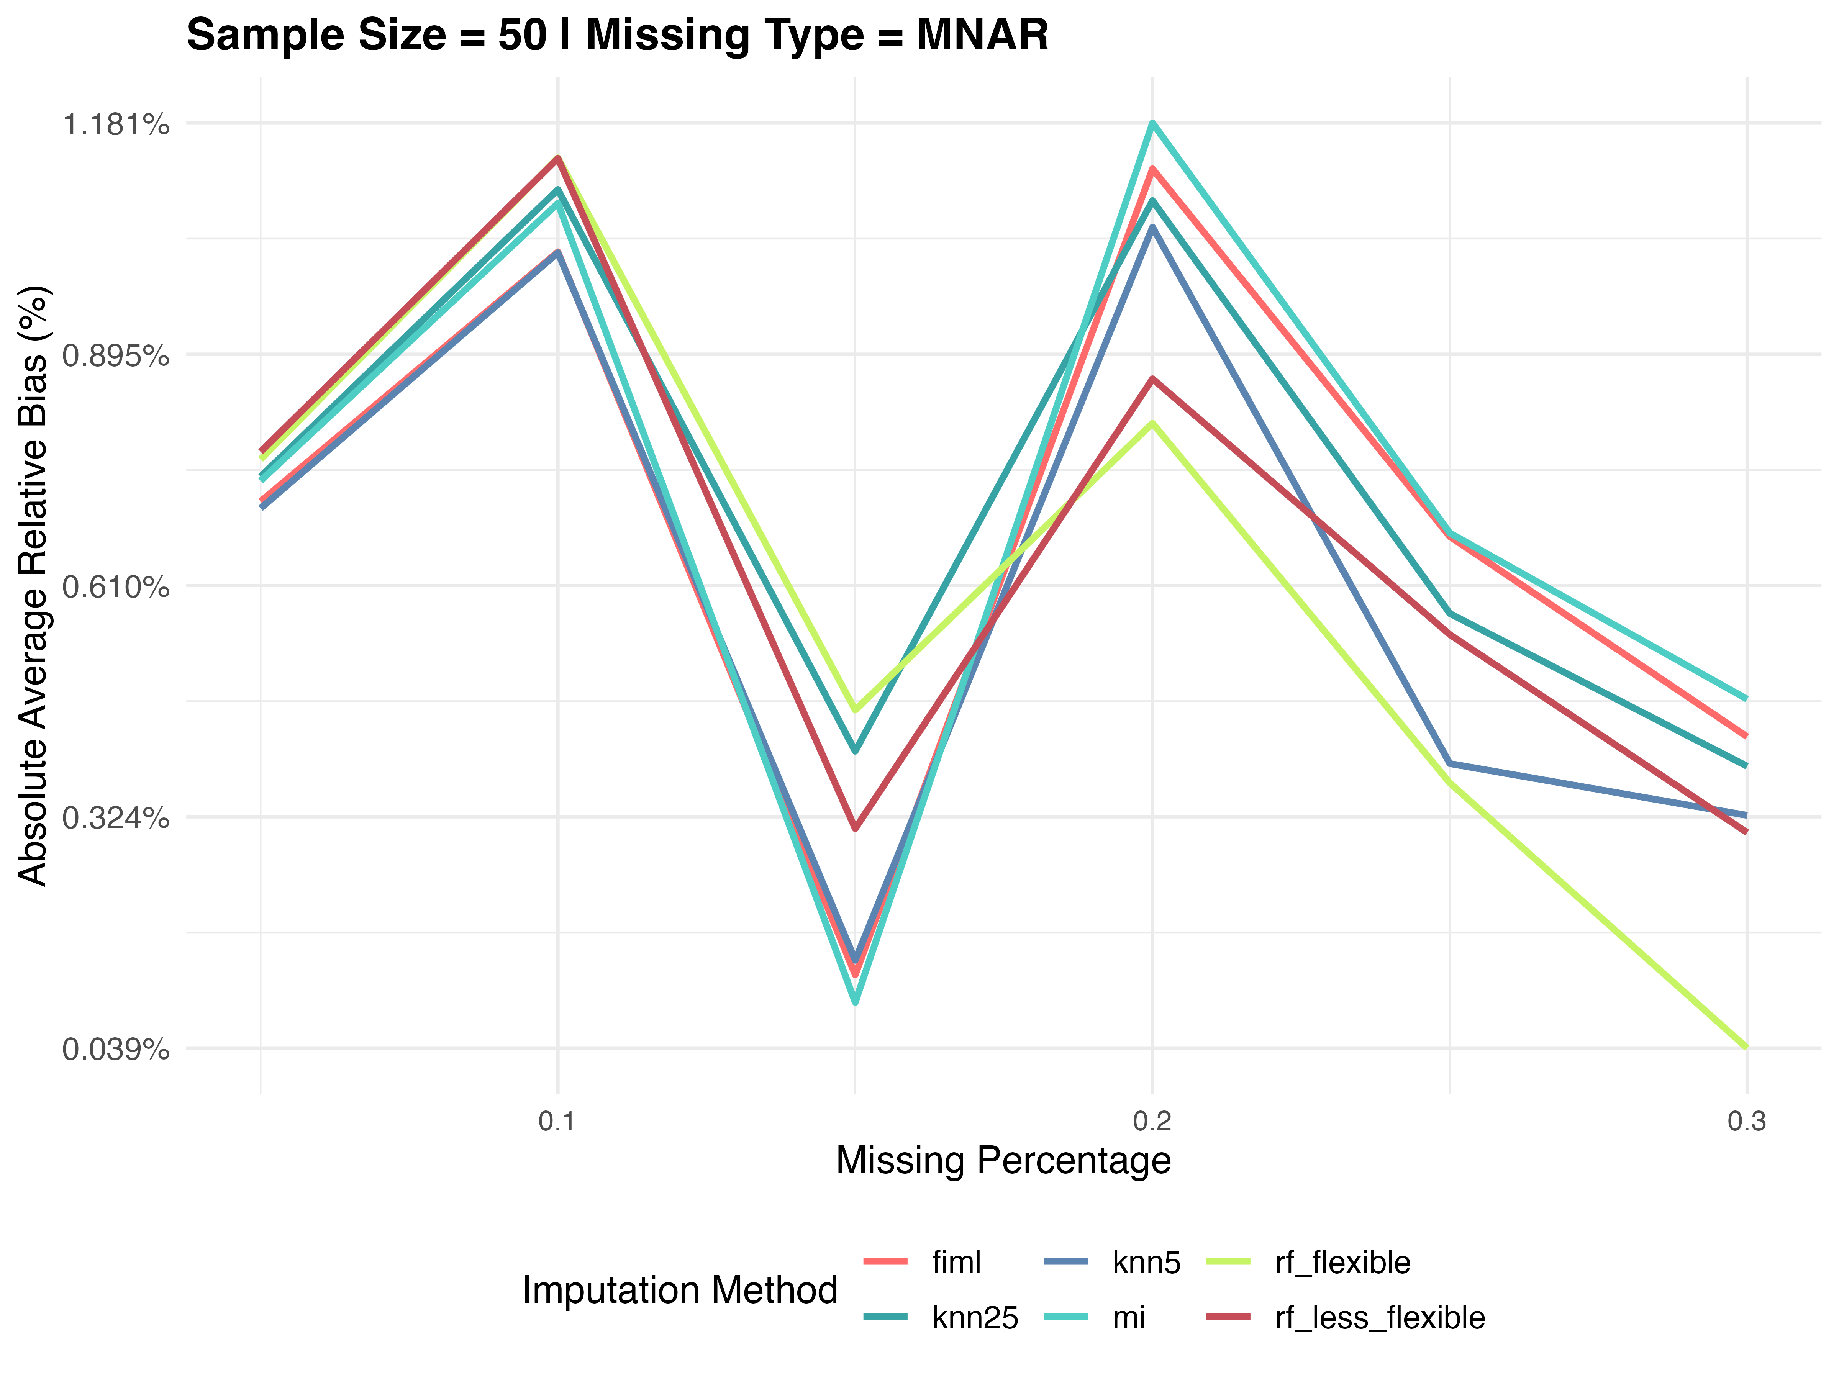
Plots for Average Relative Biases under Scenario 1

Slide 6
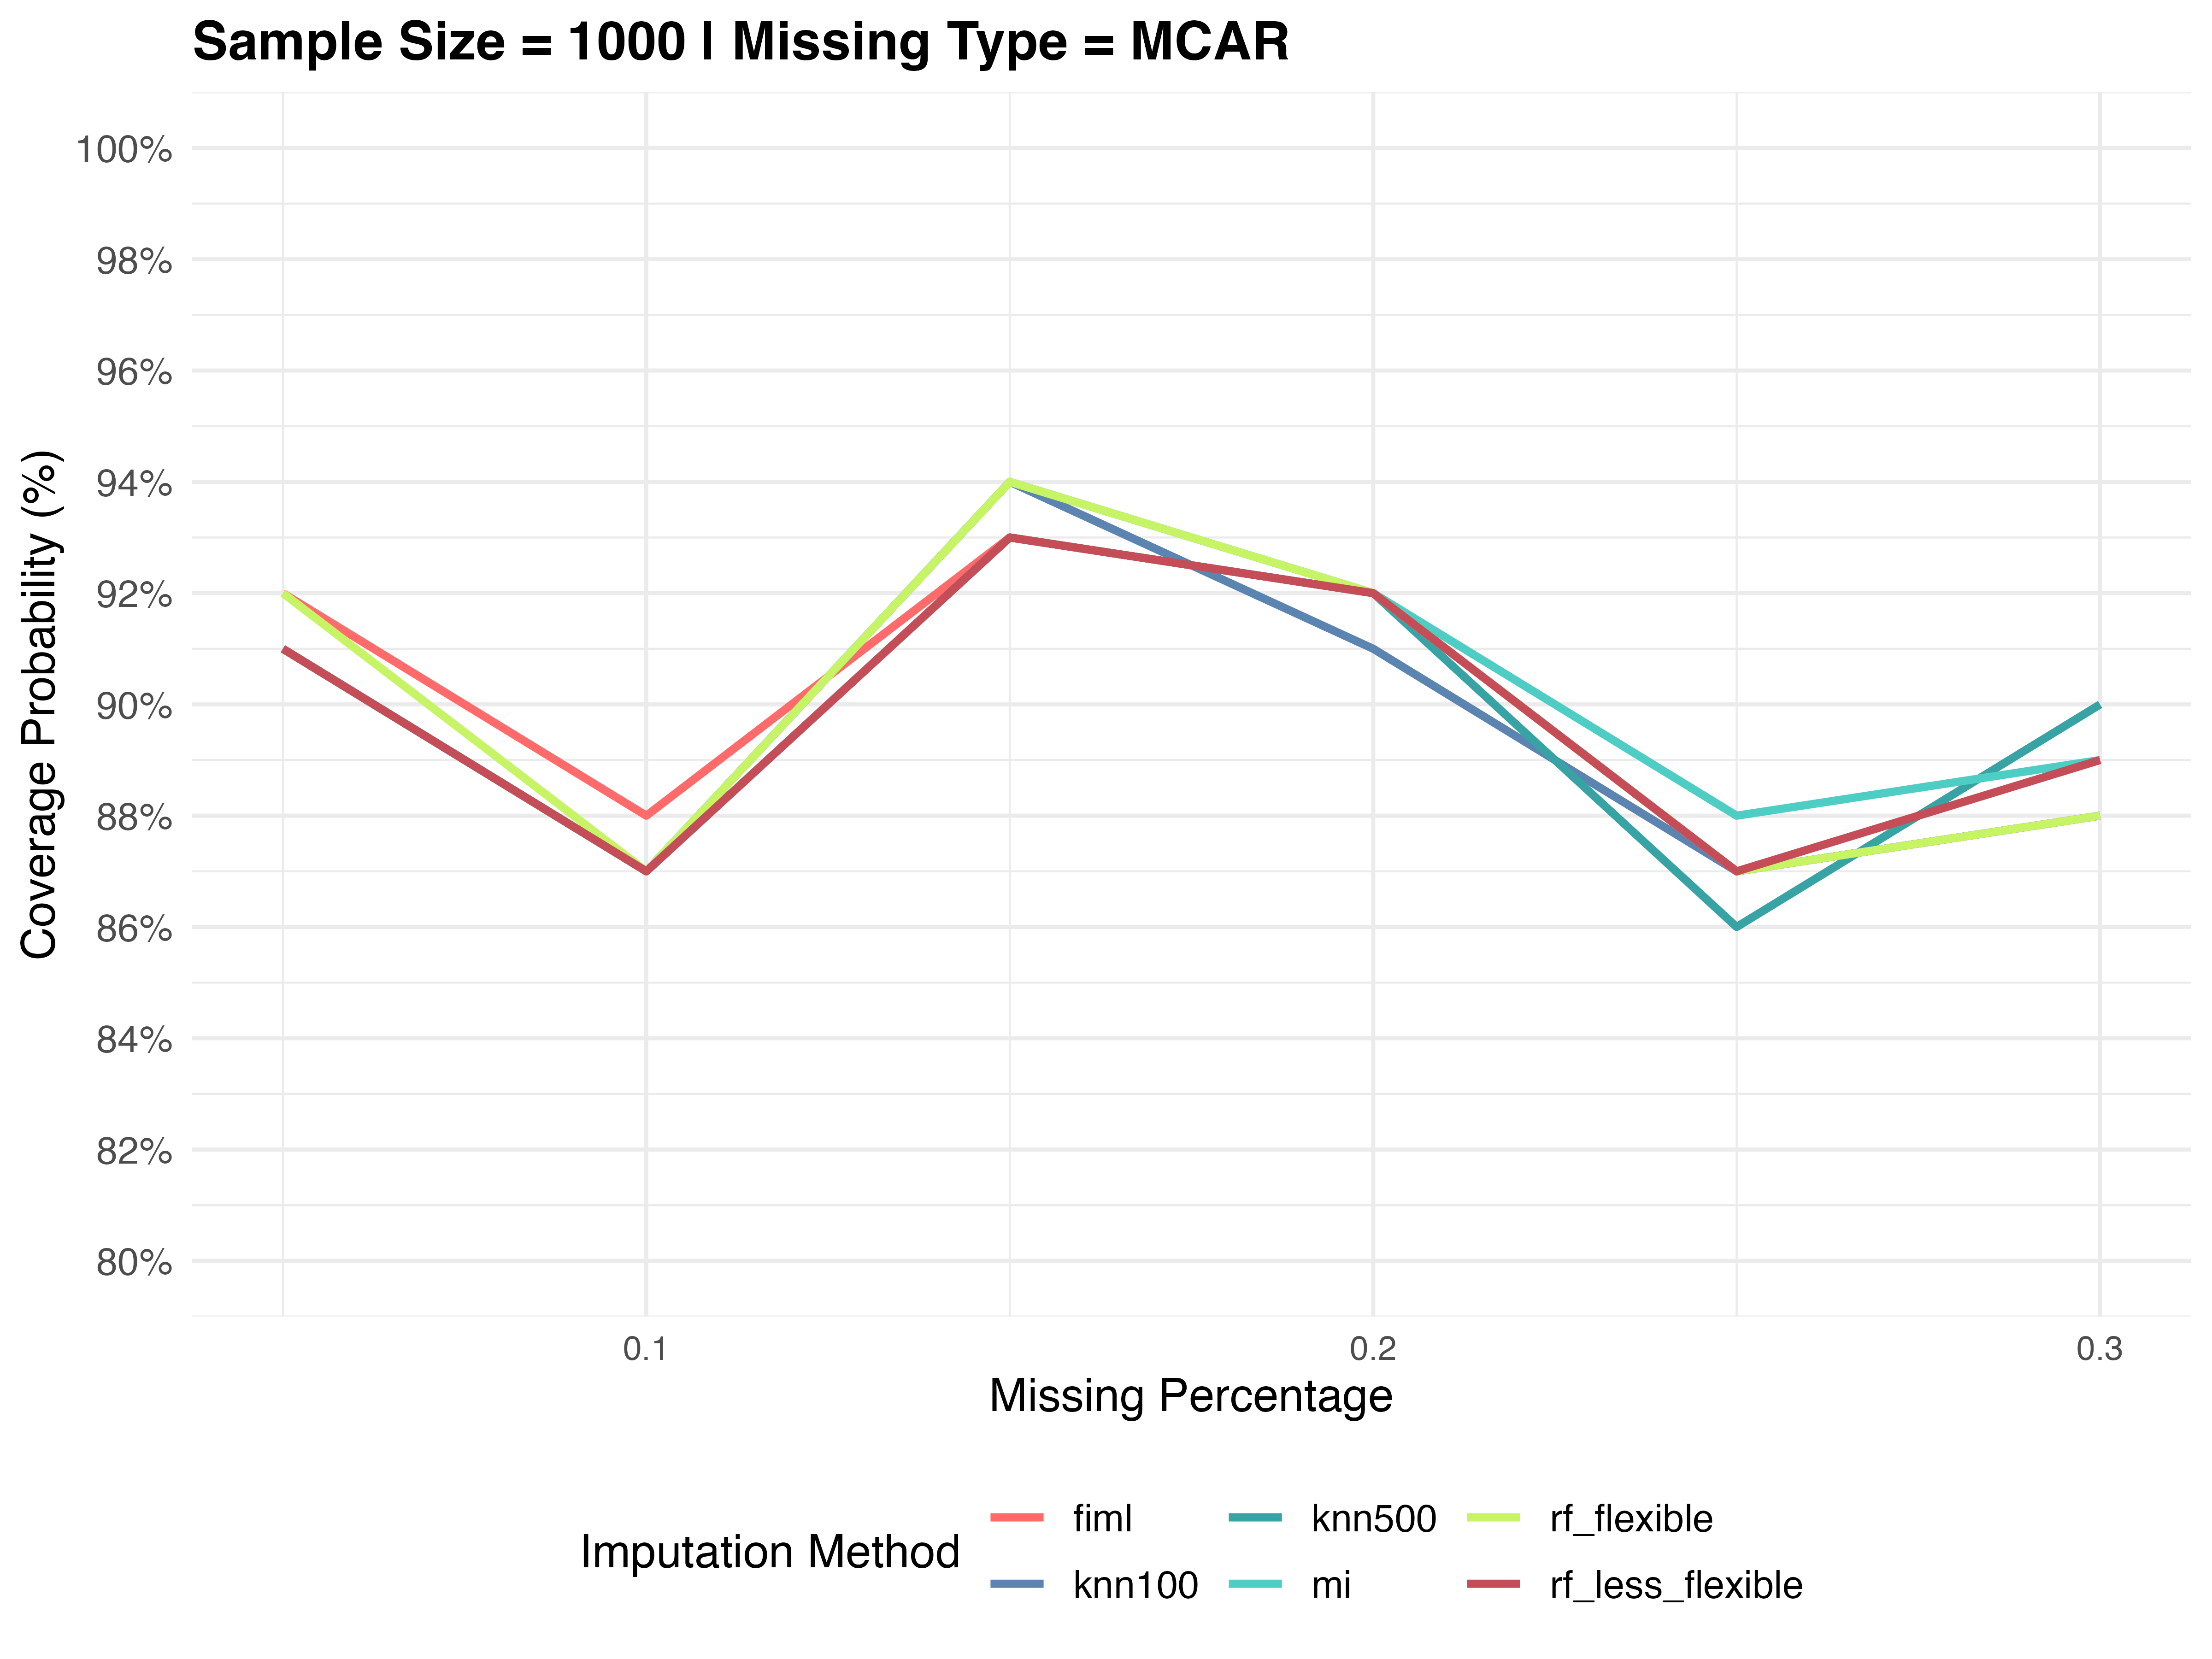
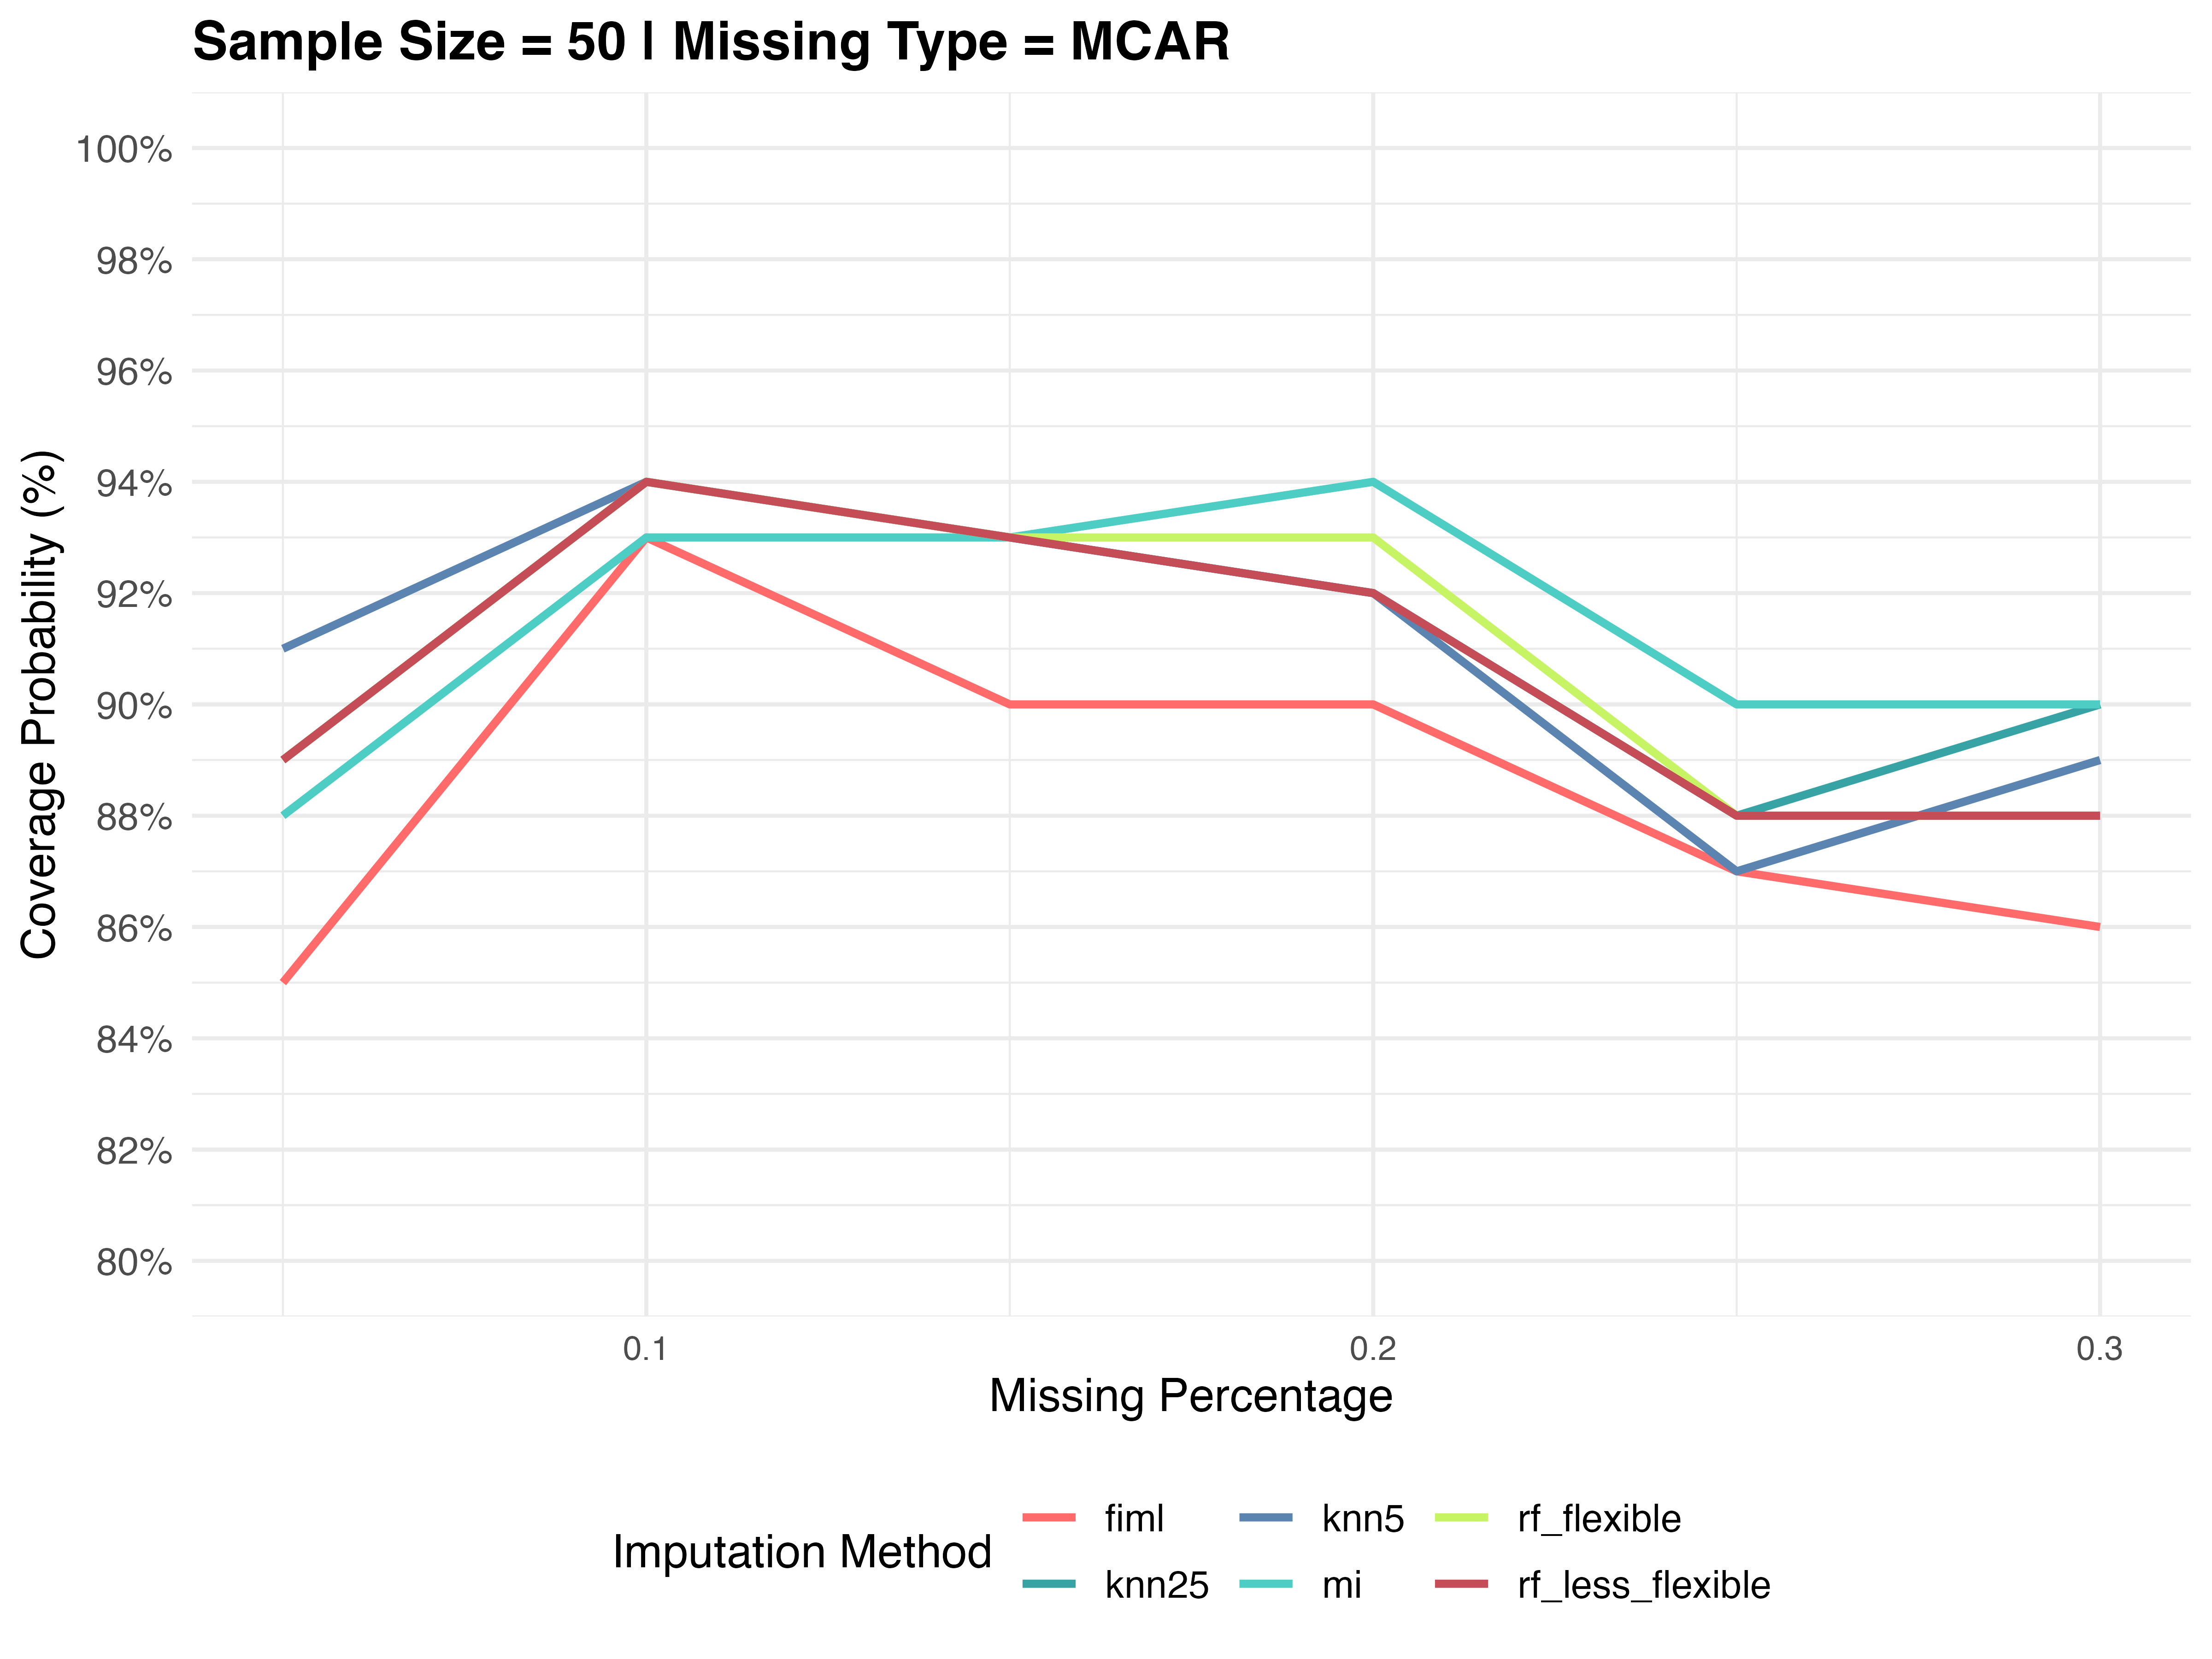
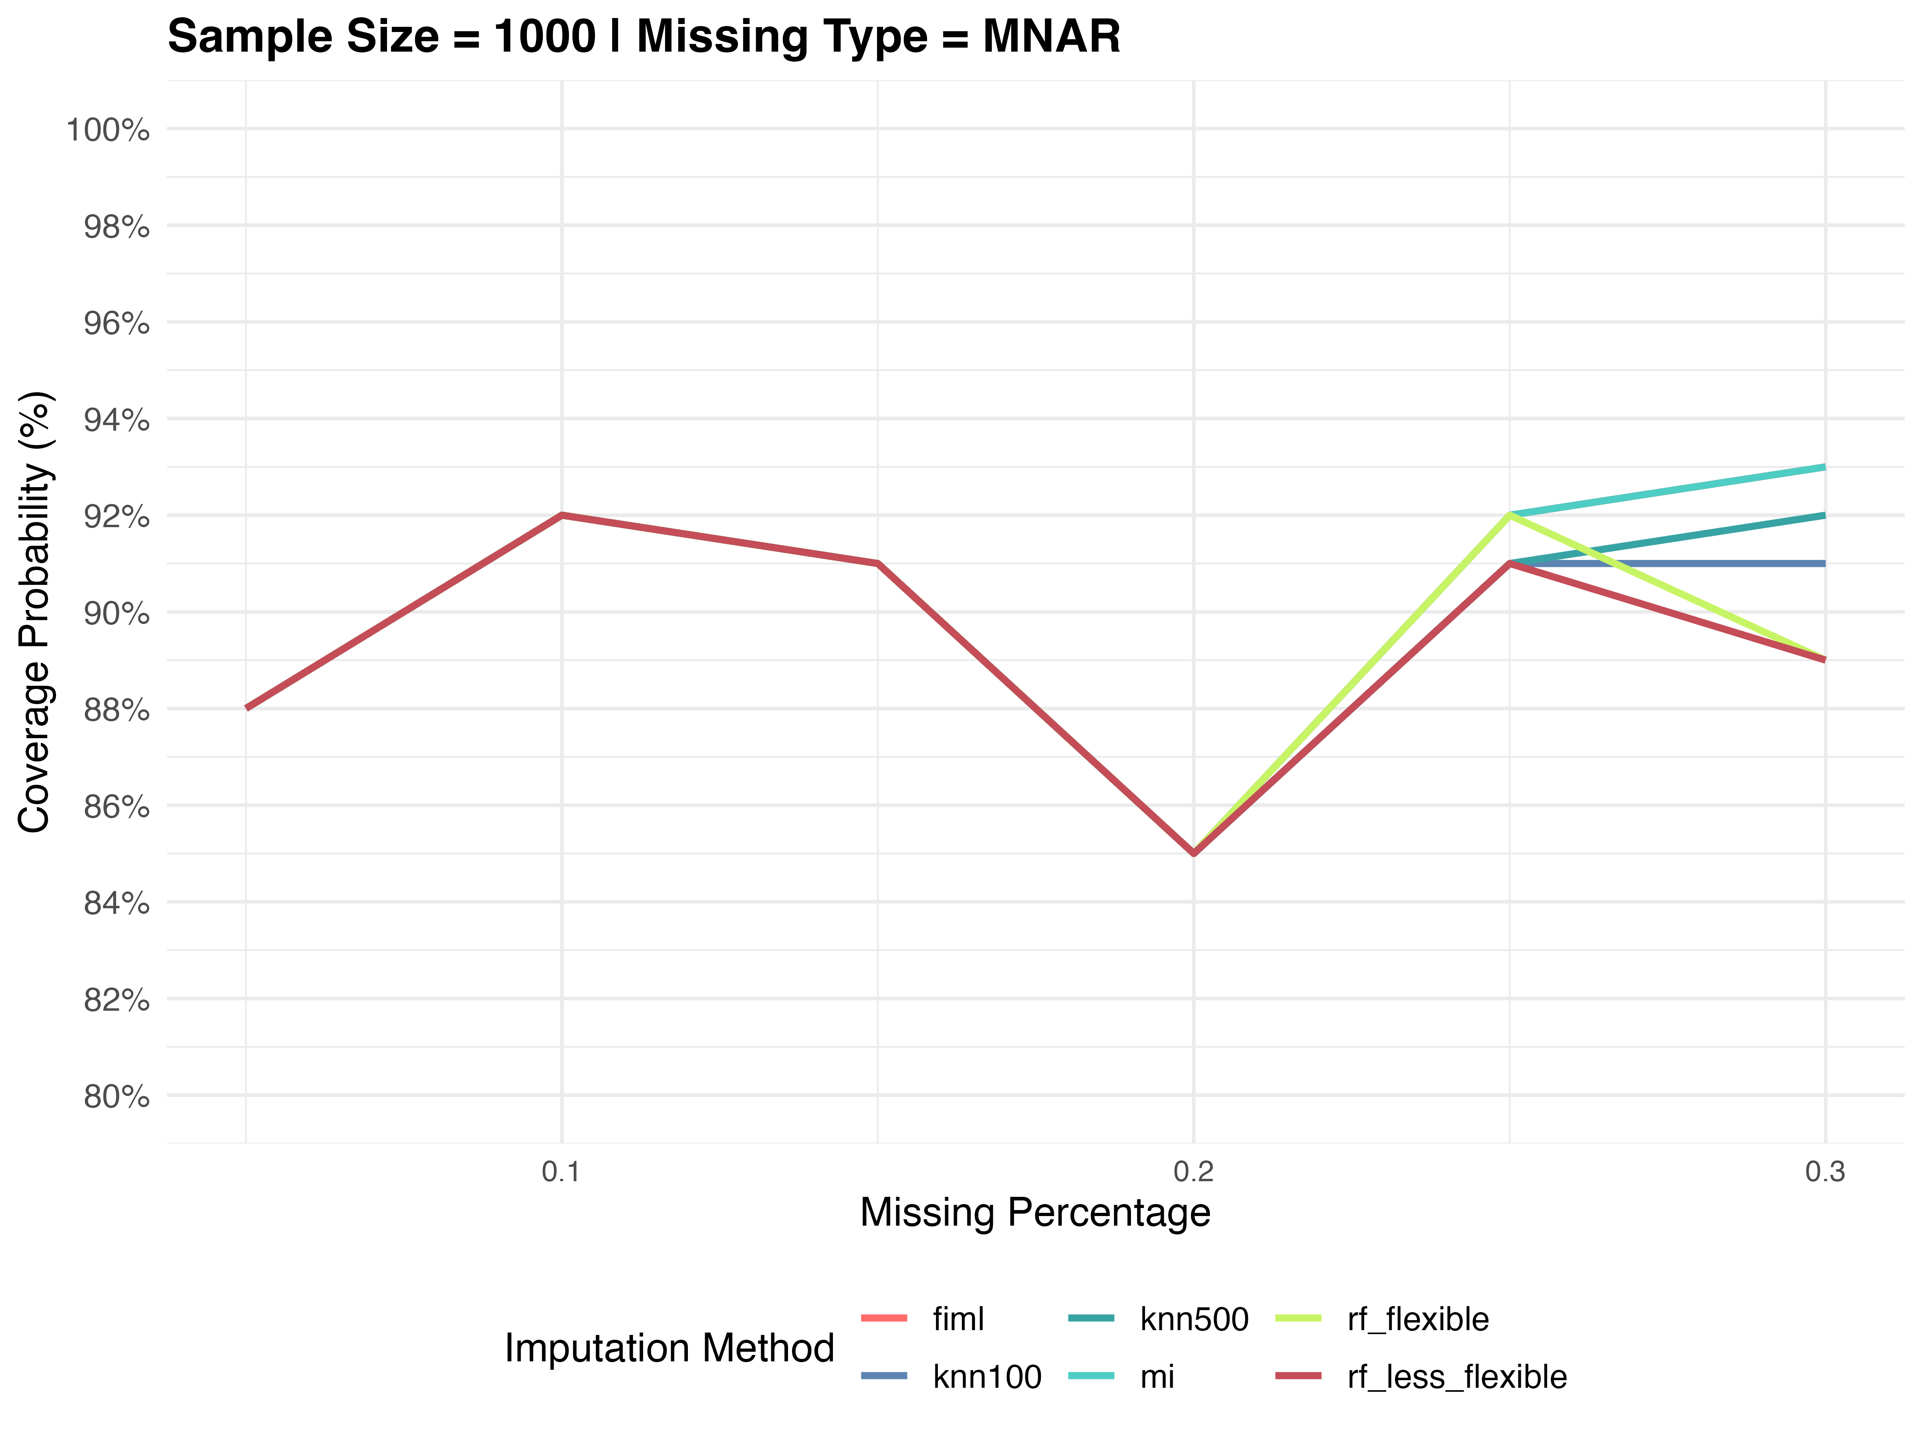
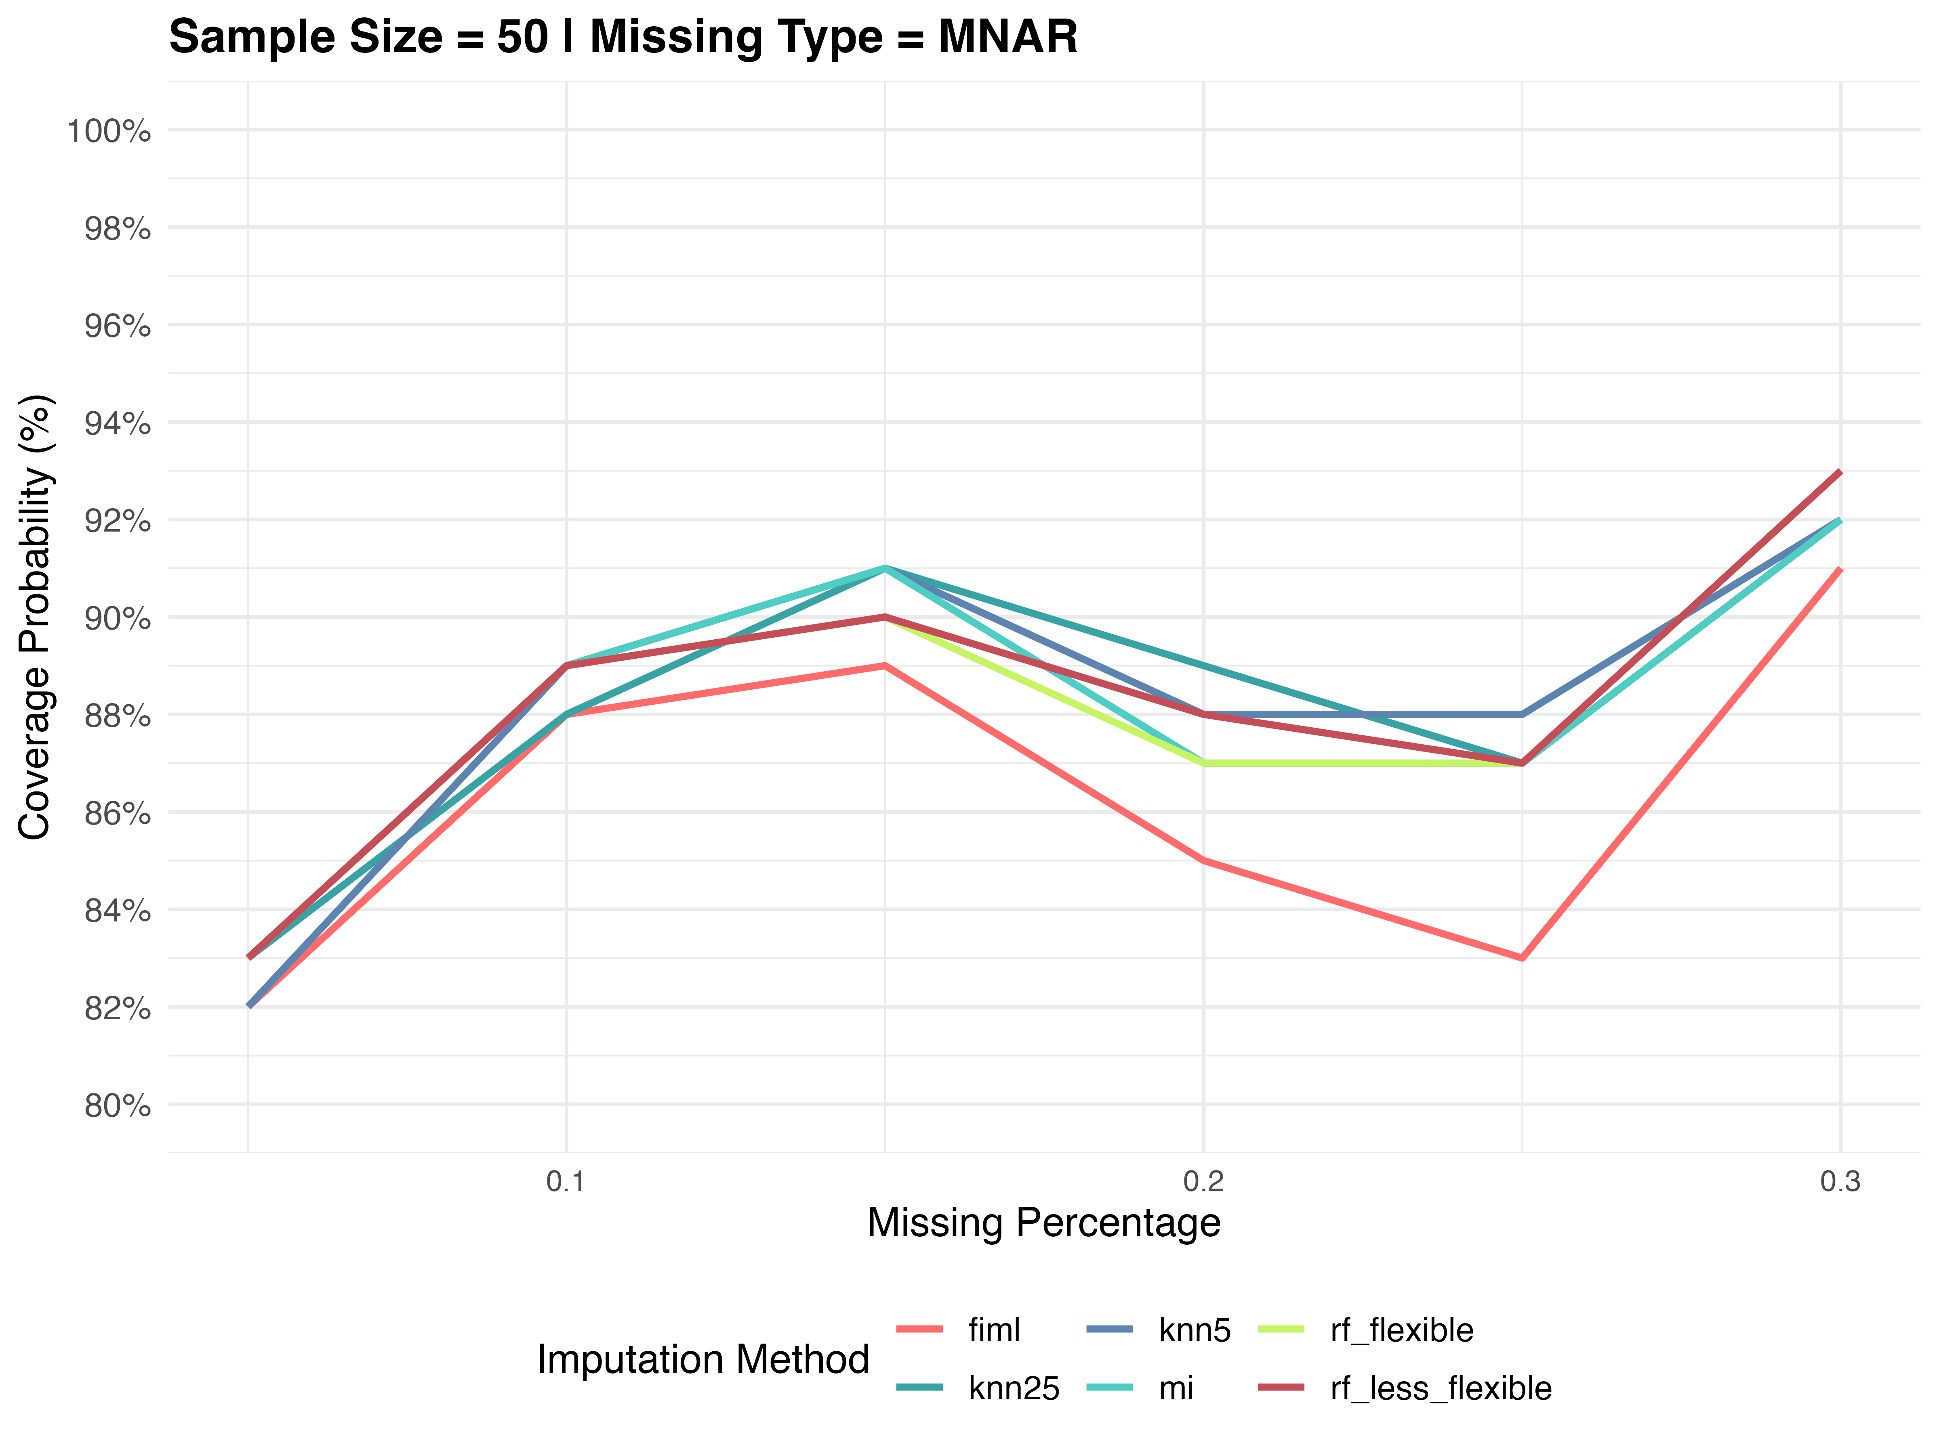
Plots for Coverage probabilities under Scenario 1

Slide 7
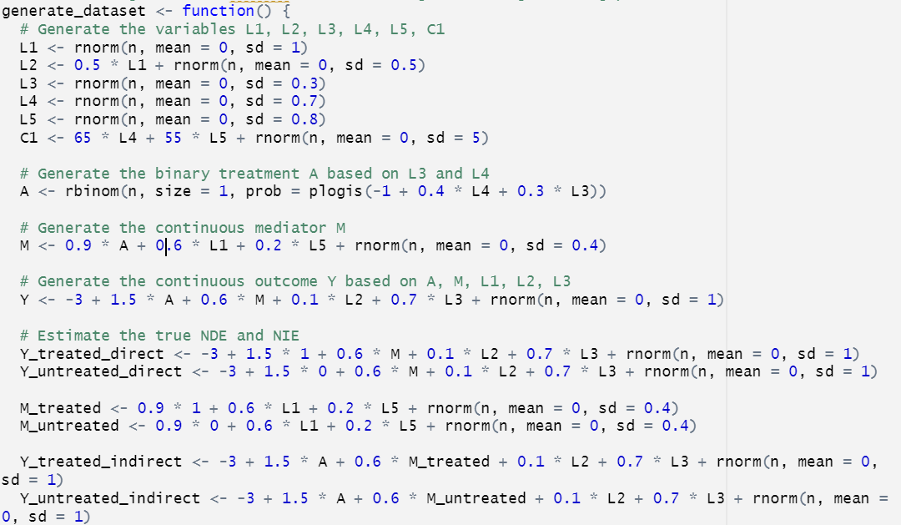
Scenario 2 – Mediator variable, Binary Treatment, Continous Outcome
C1
MCAR (Missing Completely at Random):
Evaluate the effectiveness of cardiac medications in improving long-term cardiac health, by examining how treatment influences blood pressure reduction and how these changes impact overall cardiac health scores.
L1 (Blood Pressure Level), L2 (Cholesterol Level), L3 (Genetic Predisposition to Cardiovascular Disease), L4 (BMI), L5 (Age), A (Prescription of Cardiac Medication), M (Reduction in Systolic Blood Pressure), C1 (Cardiovascular Risk Score), Y (Cardiac Health Score)
Data entry error/ Data lost at random in L1 (Blood pressure level)
L3
L4
L5
A
M
Y
L1
L2
MNAR (Missing not at Random):
Assess the efficacy of mental health interventions, specifically cognitive behavioral therapy, in improving mood and overall mental health outcomes.
L1 (Severity of Depressive Symptoms), L2 (Anxiety Level), L3 (Genetic Predisposition to Mental Health Disorders), L4 (Physical Activity Level), L5 (Social Support Level), A (Enrollment in a Mental Health Program), M (Improvement in Mood Scores), C1 (Mental Well-being Index), Y (Overall Mental Health Outcome)
L1 is subject to missingness due to stigma, Higher the depression symptoms, more probability of missingness.

Slide 8
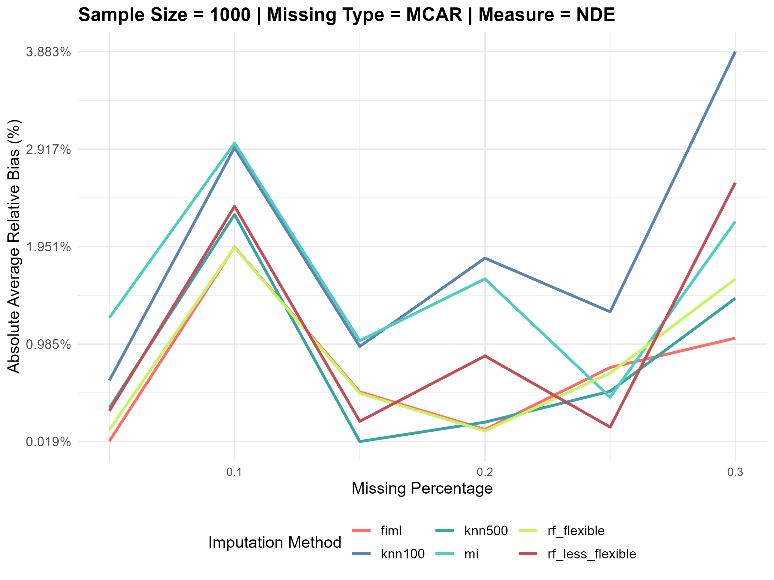
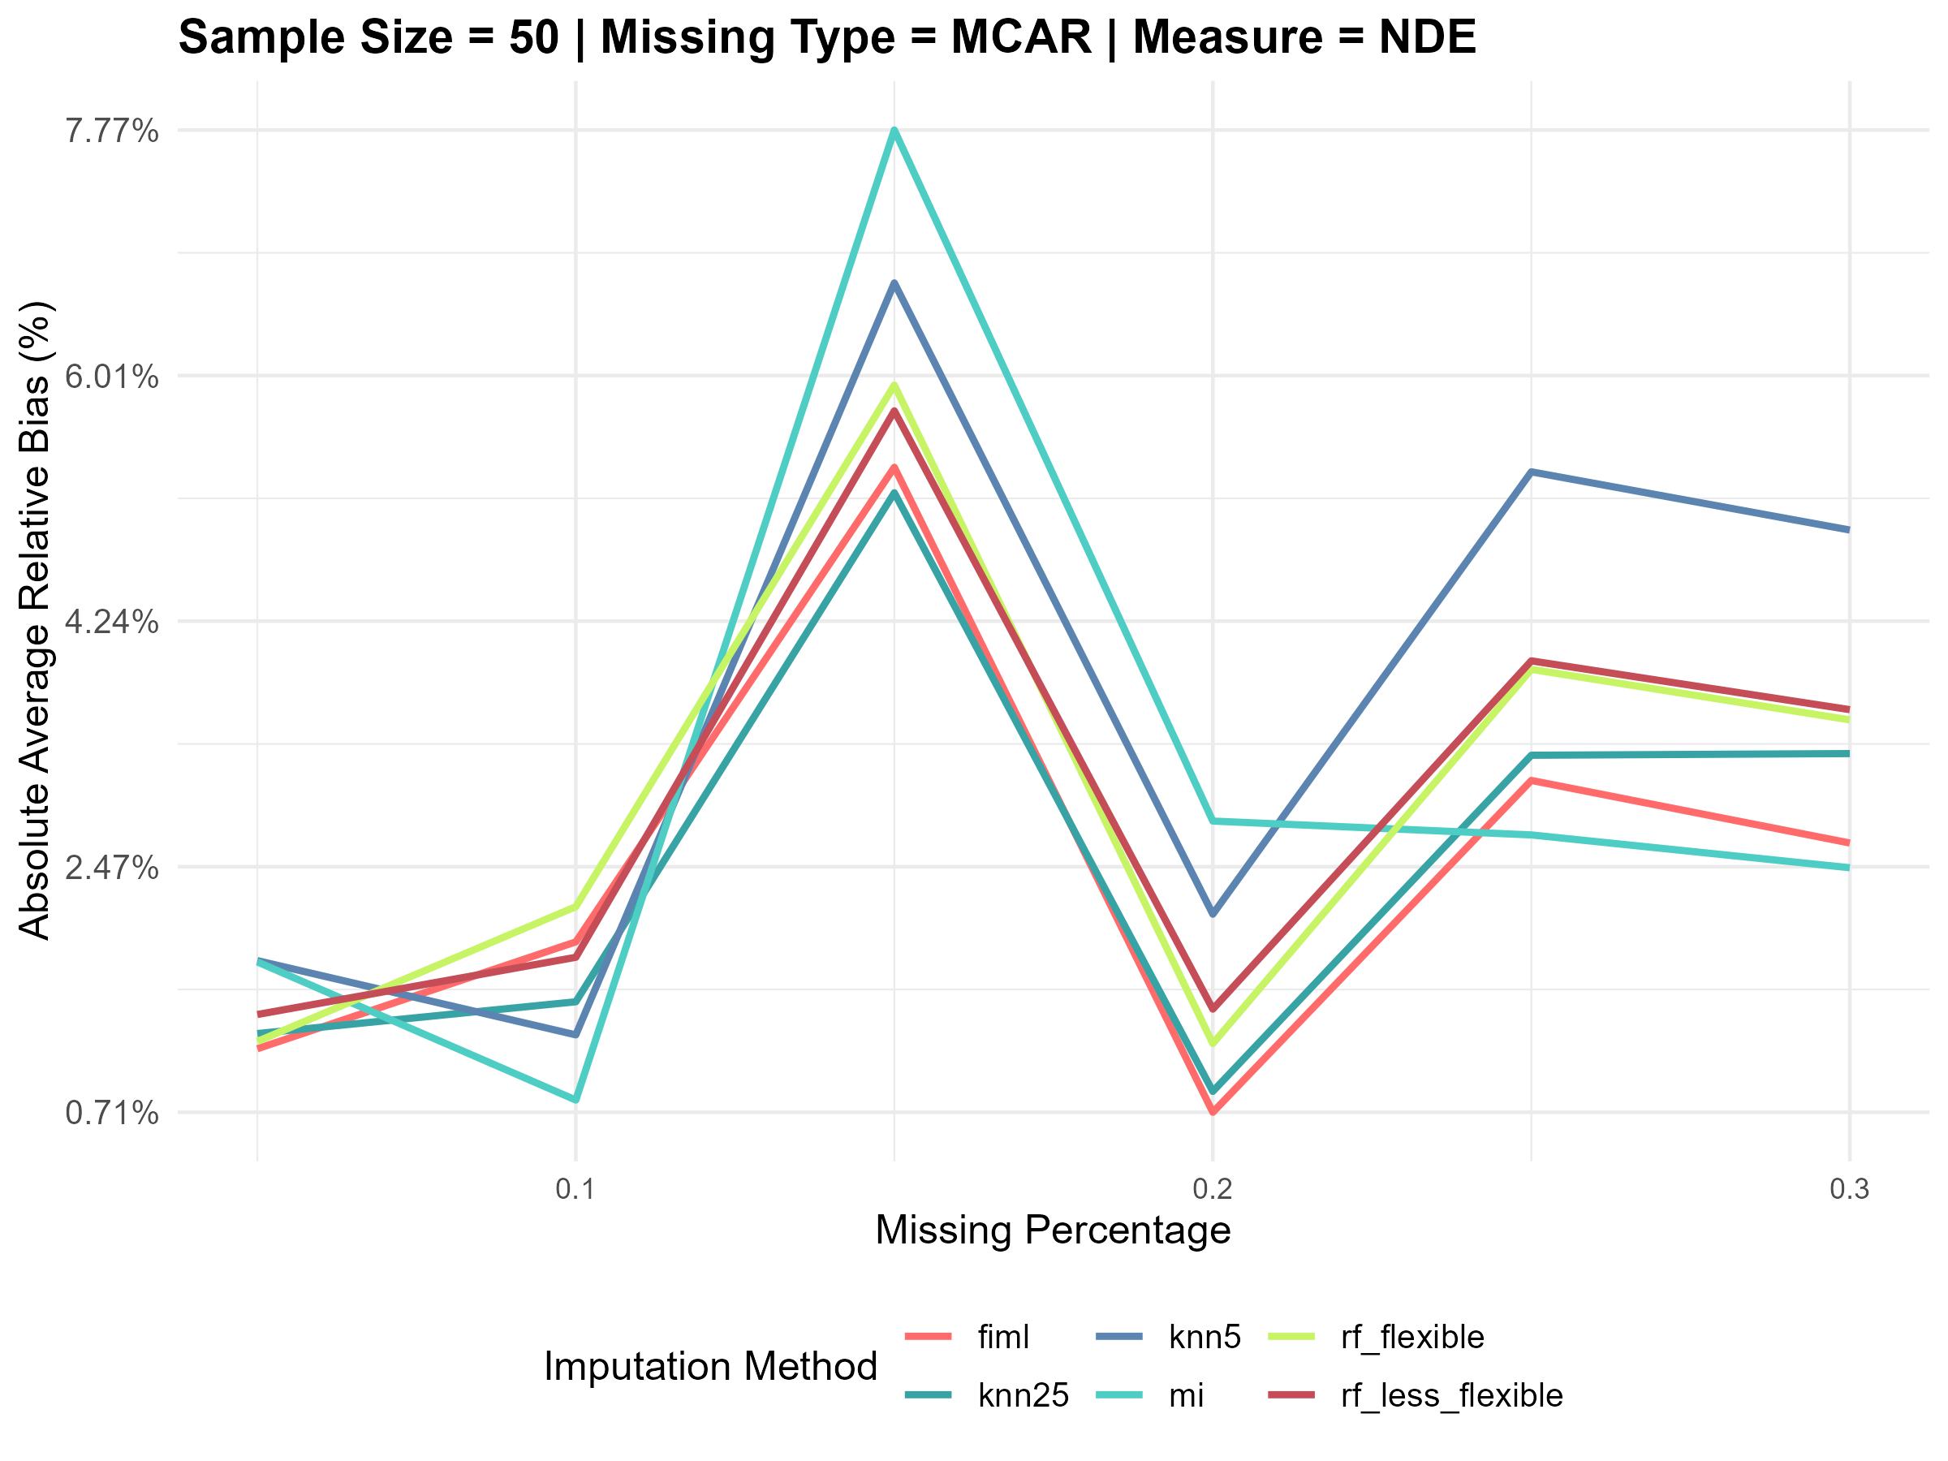
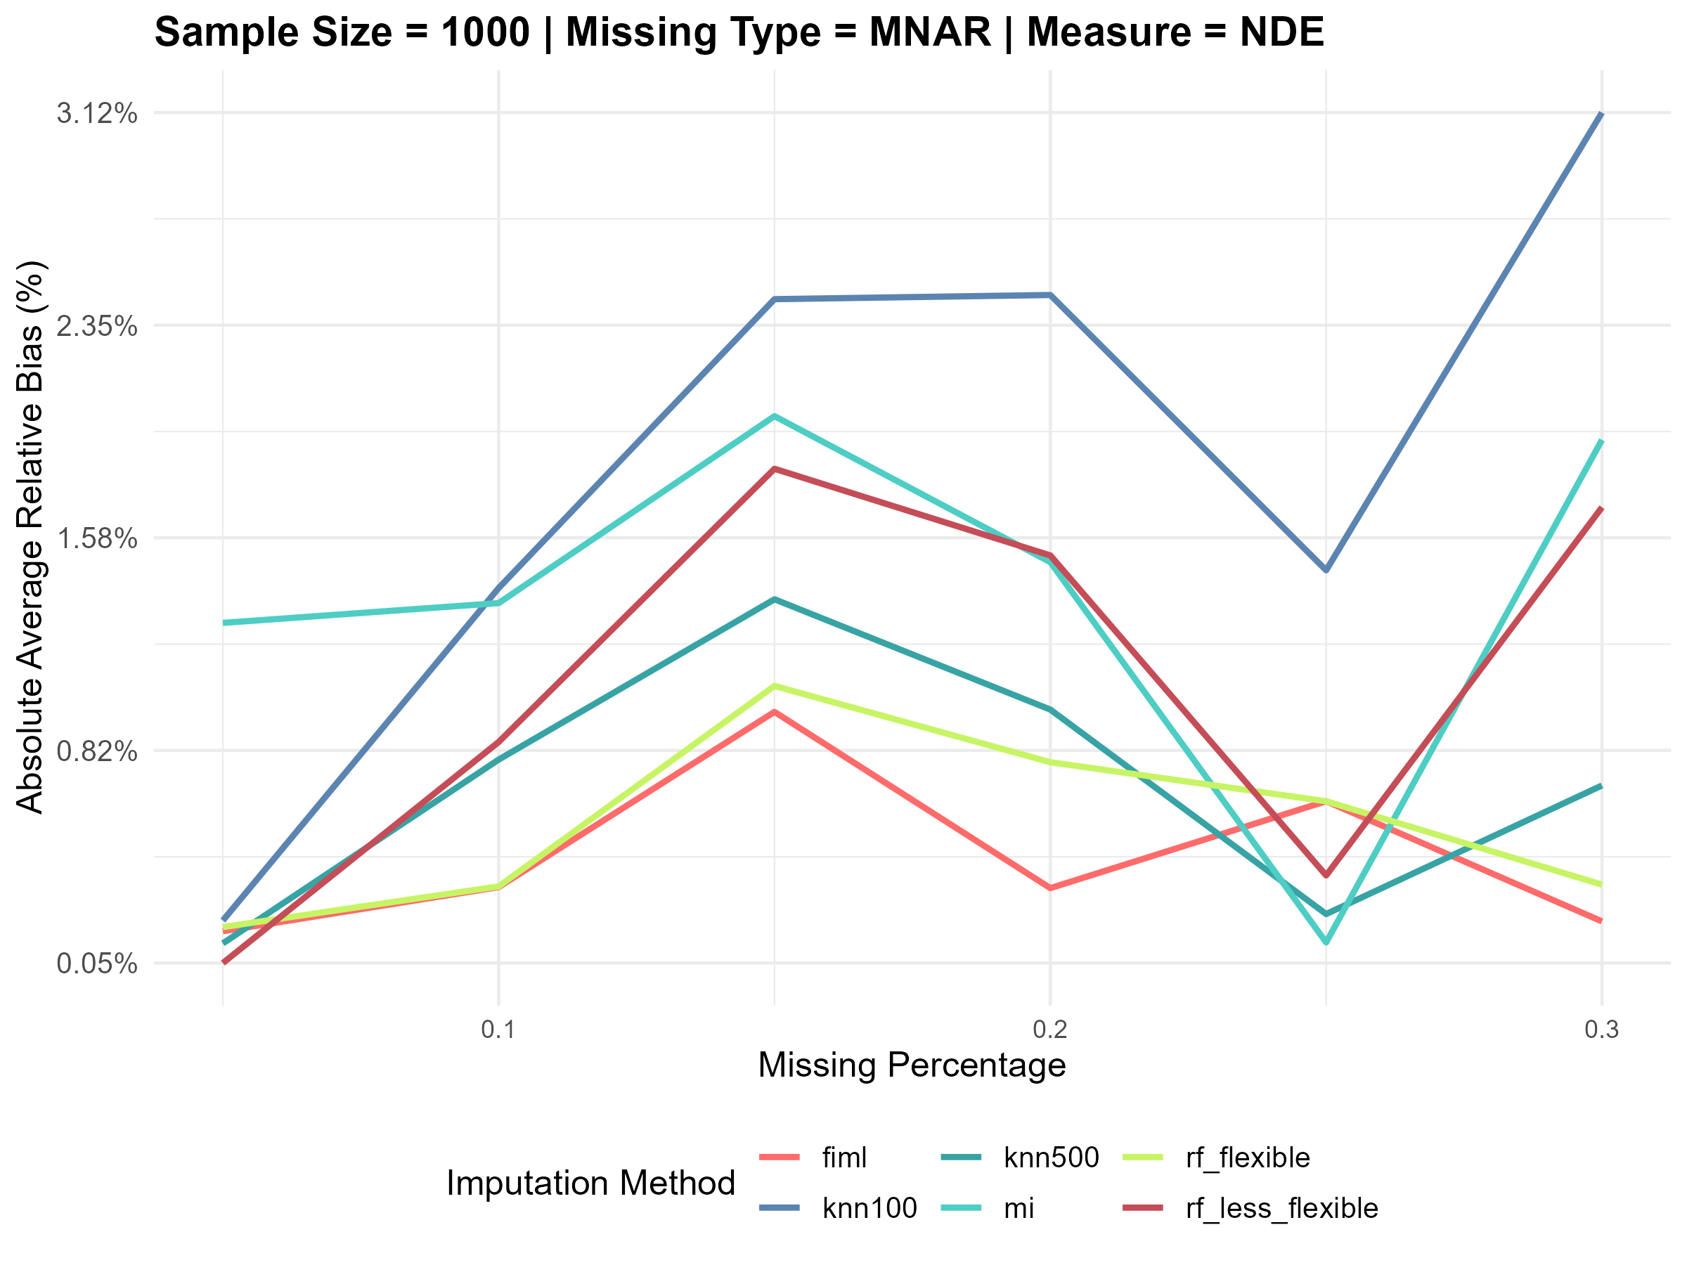
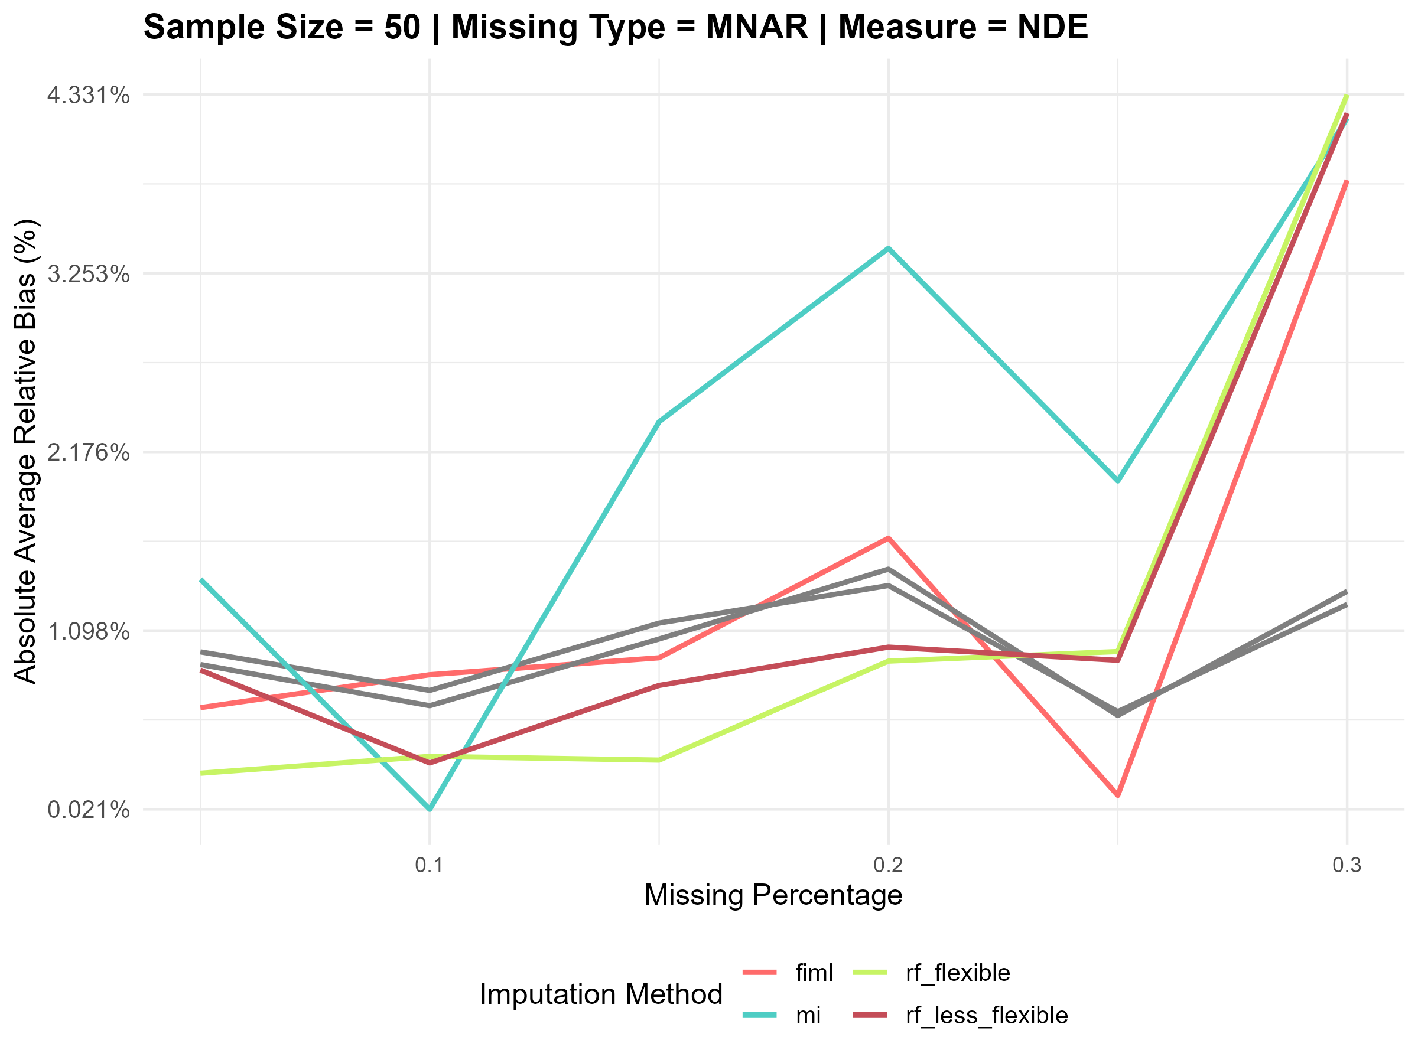
Plots for Average Relative Biases (NDE) under Scenario 2

Slide 9
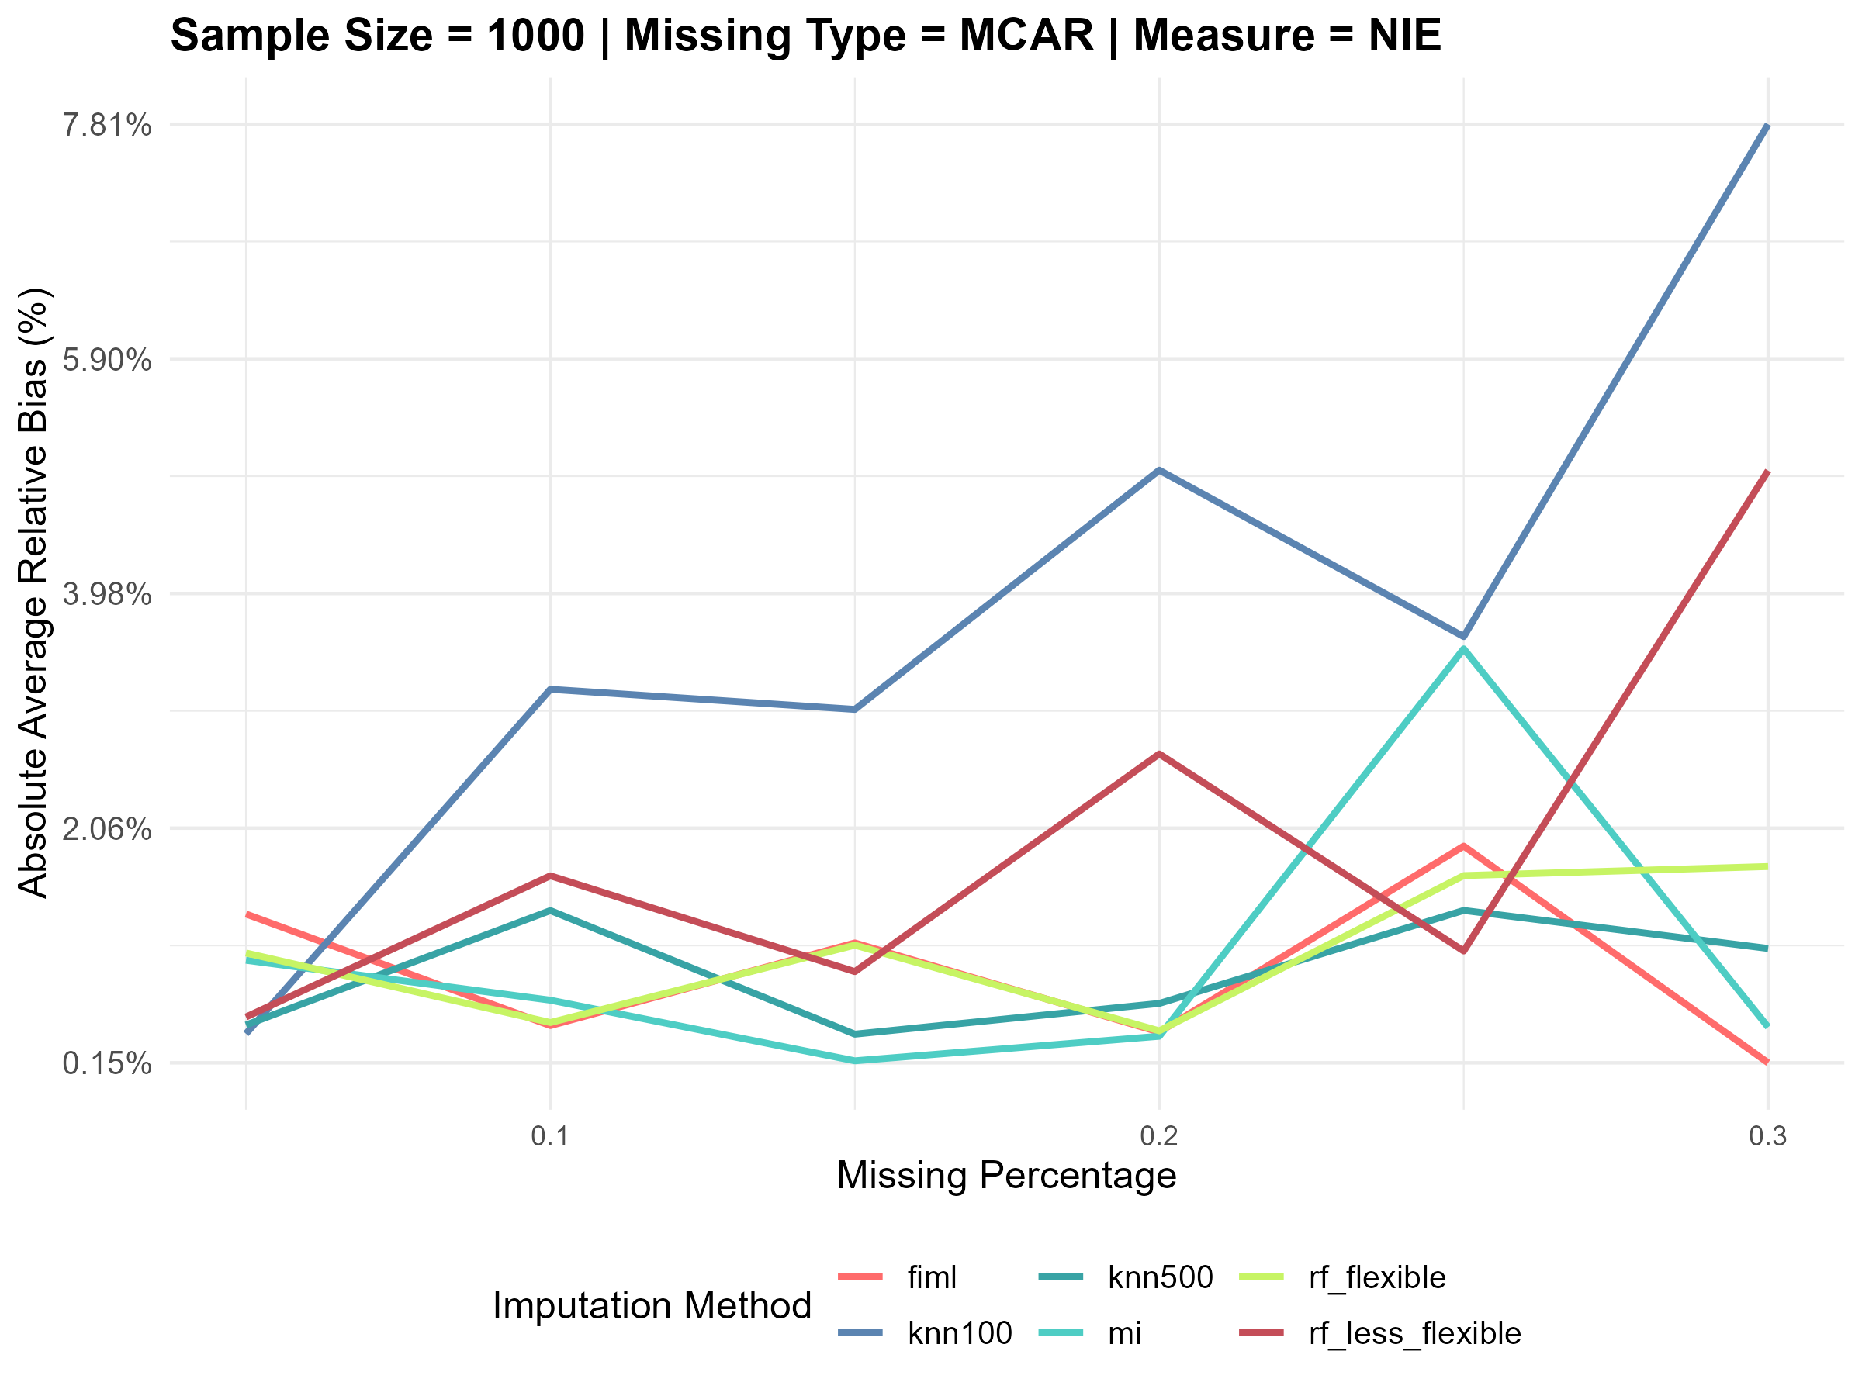
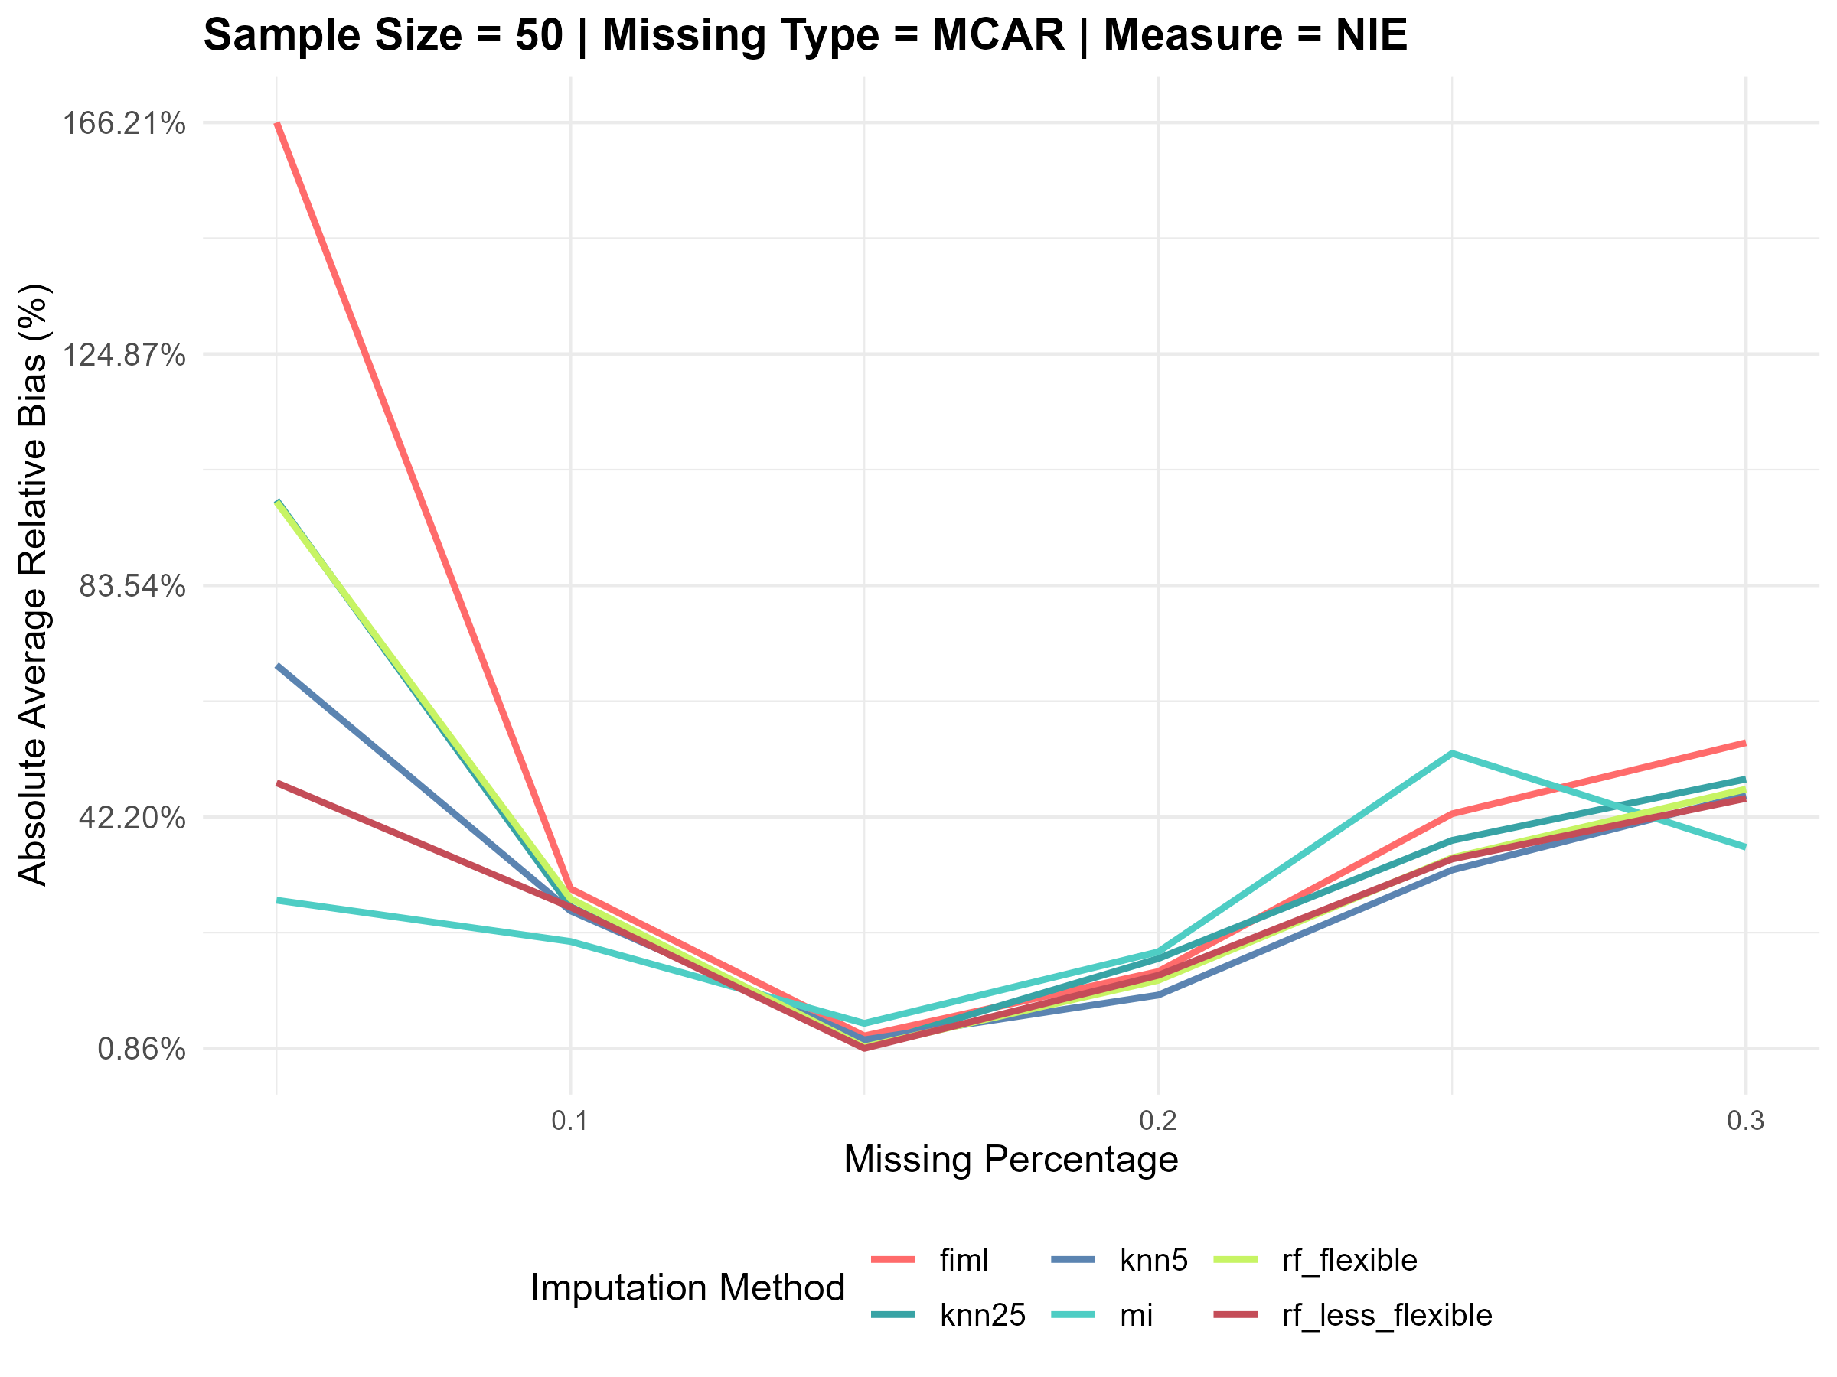
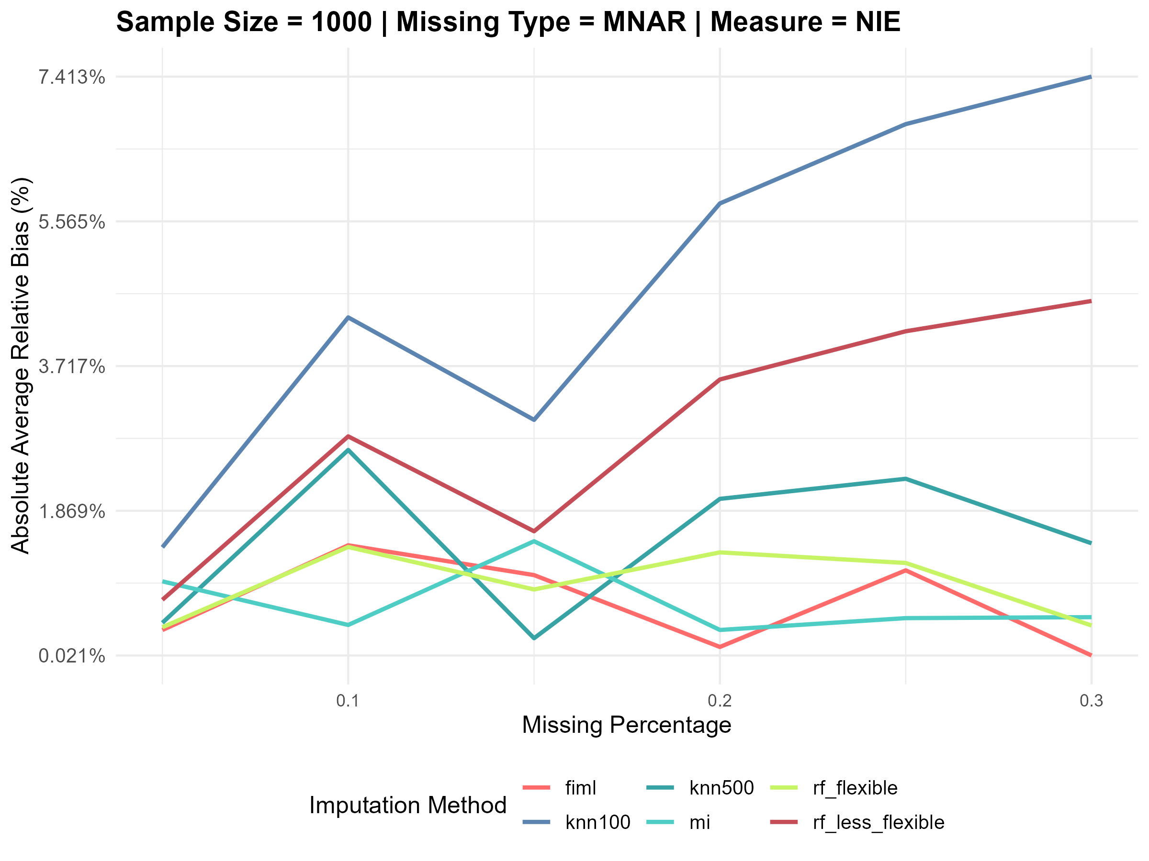
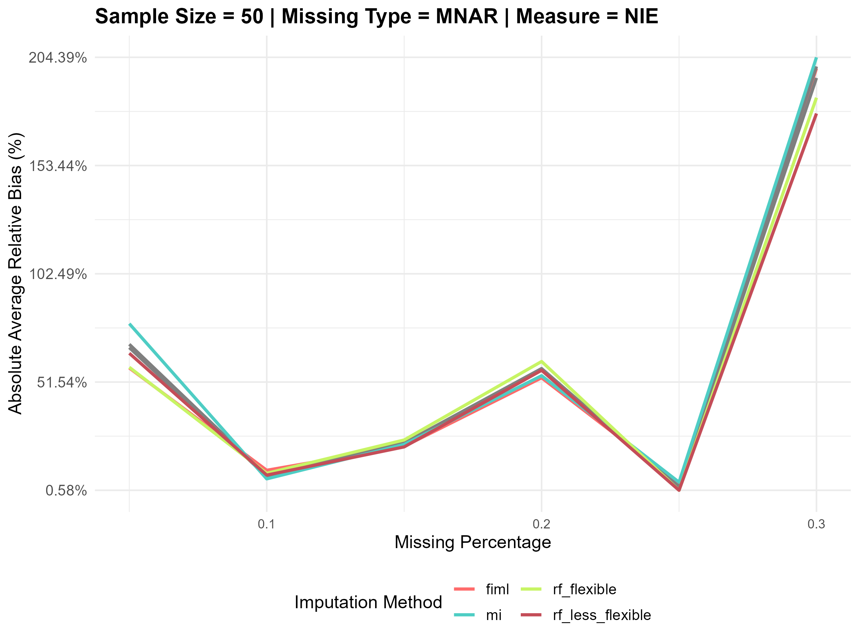
Plots for Average Relative Biases (NIE) under Scenario 2

Slide 10
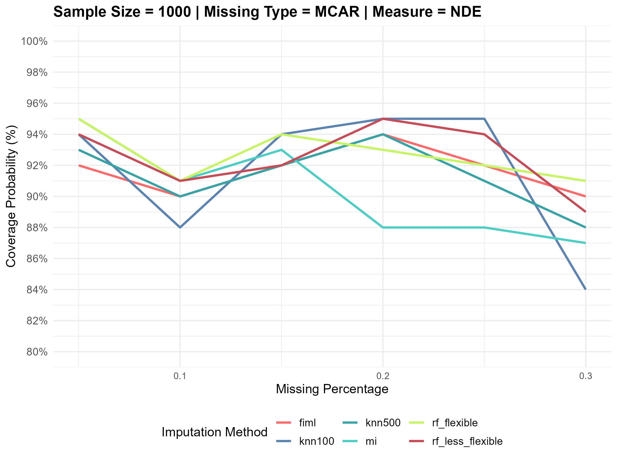
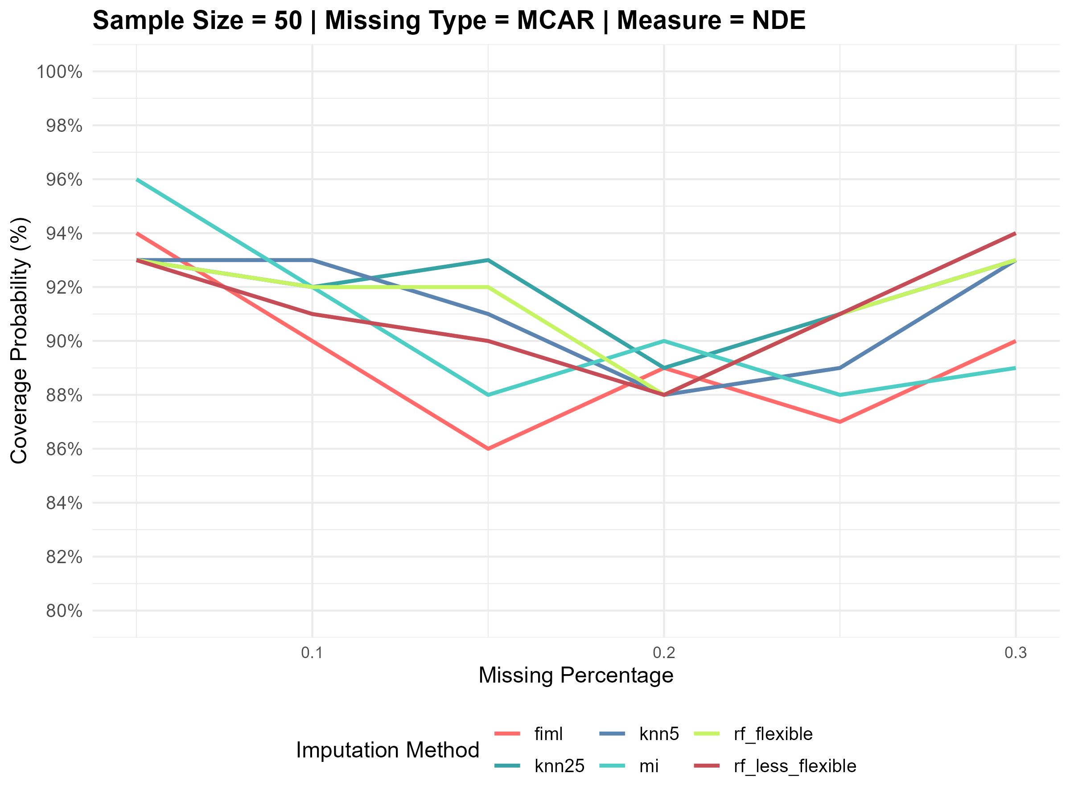
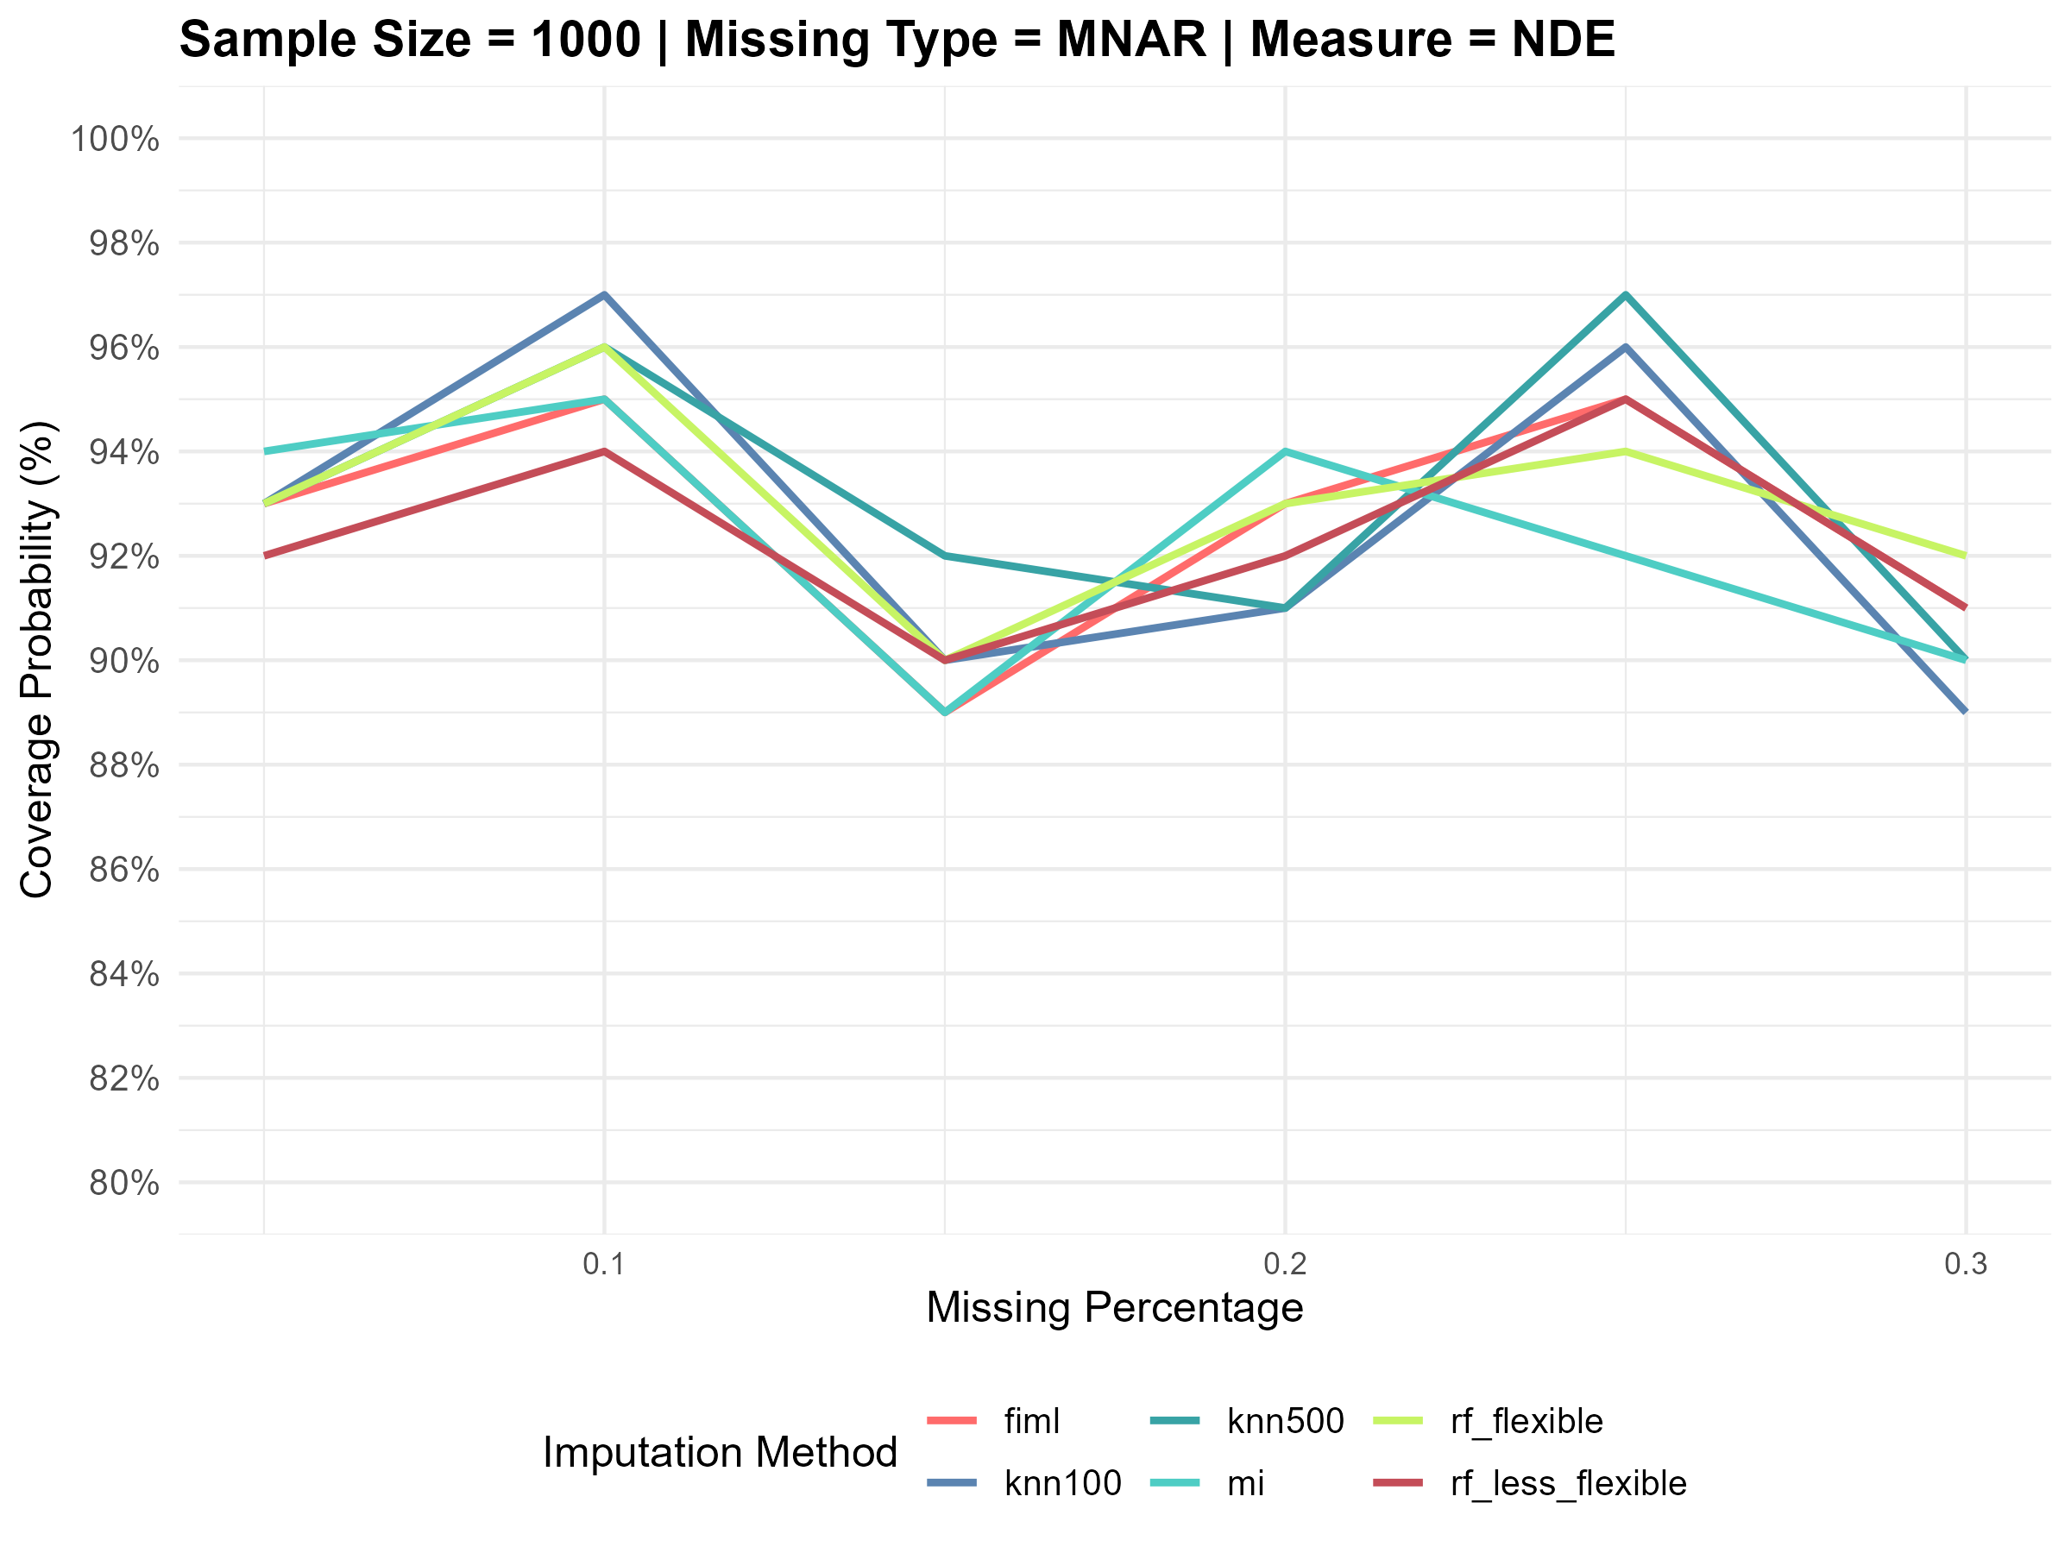
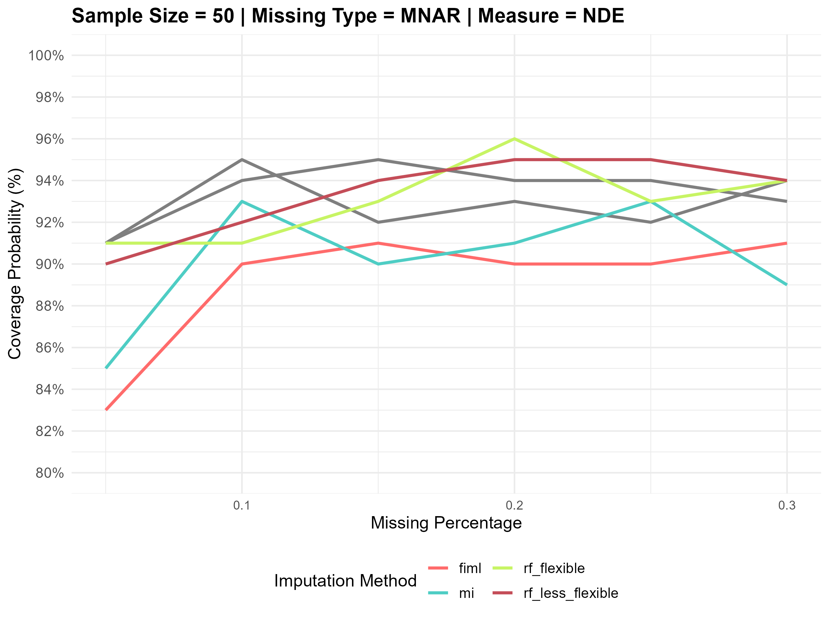
Plots for Coverage probabilities(NDE) under Scenario 2

Slide 11
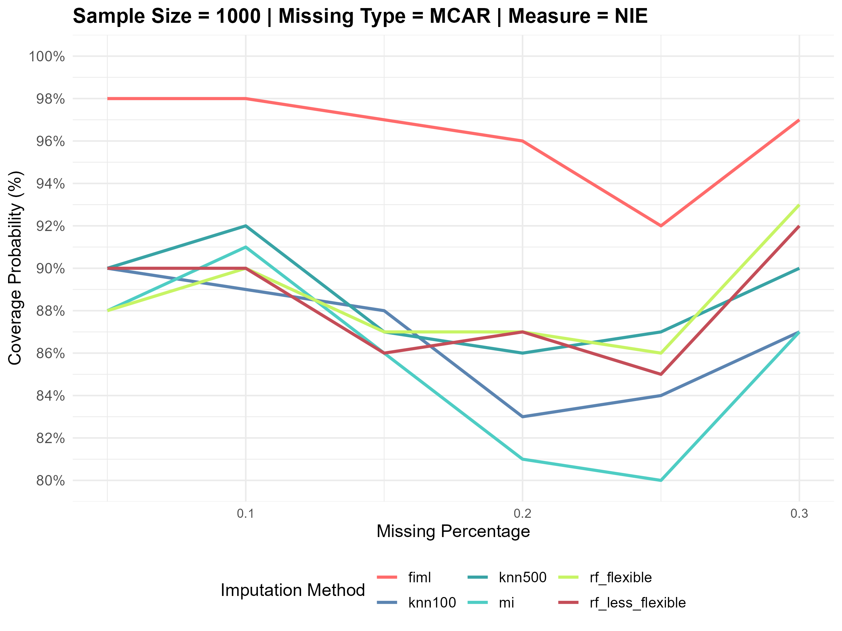
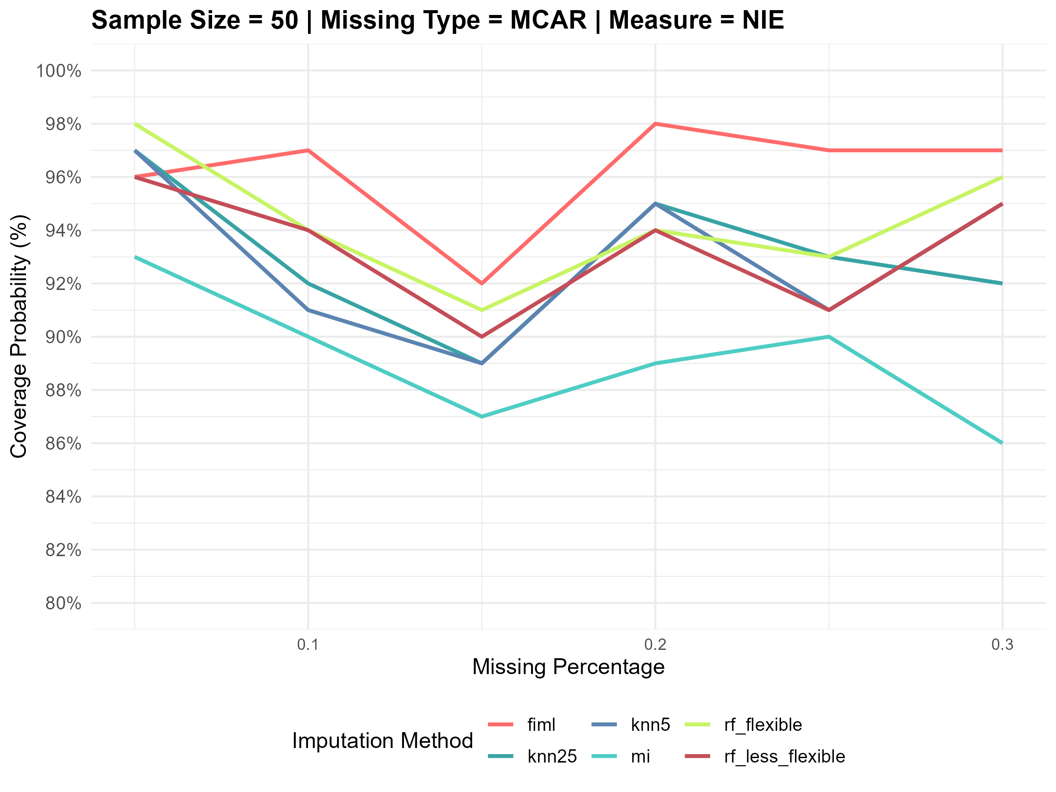
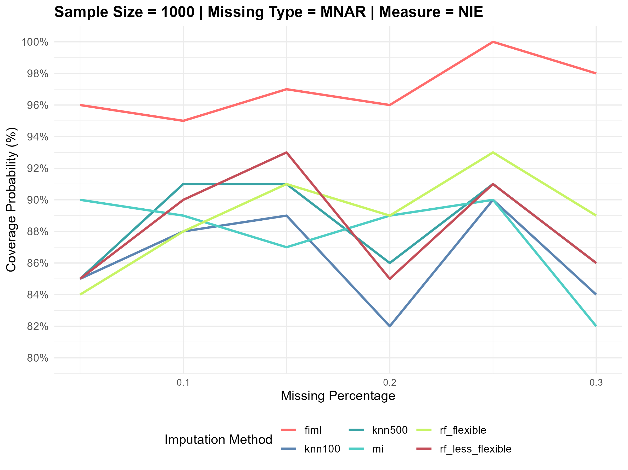
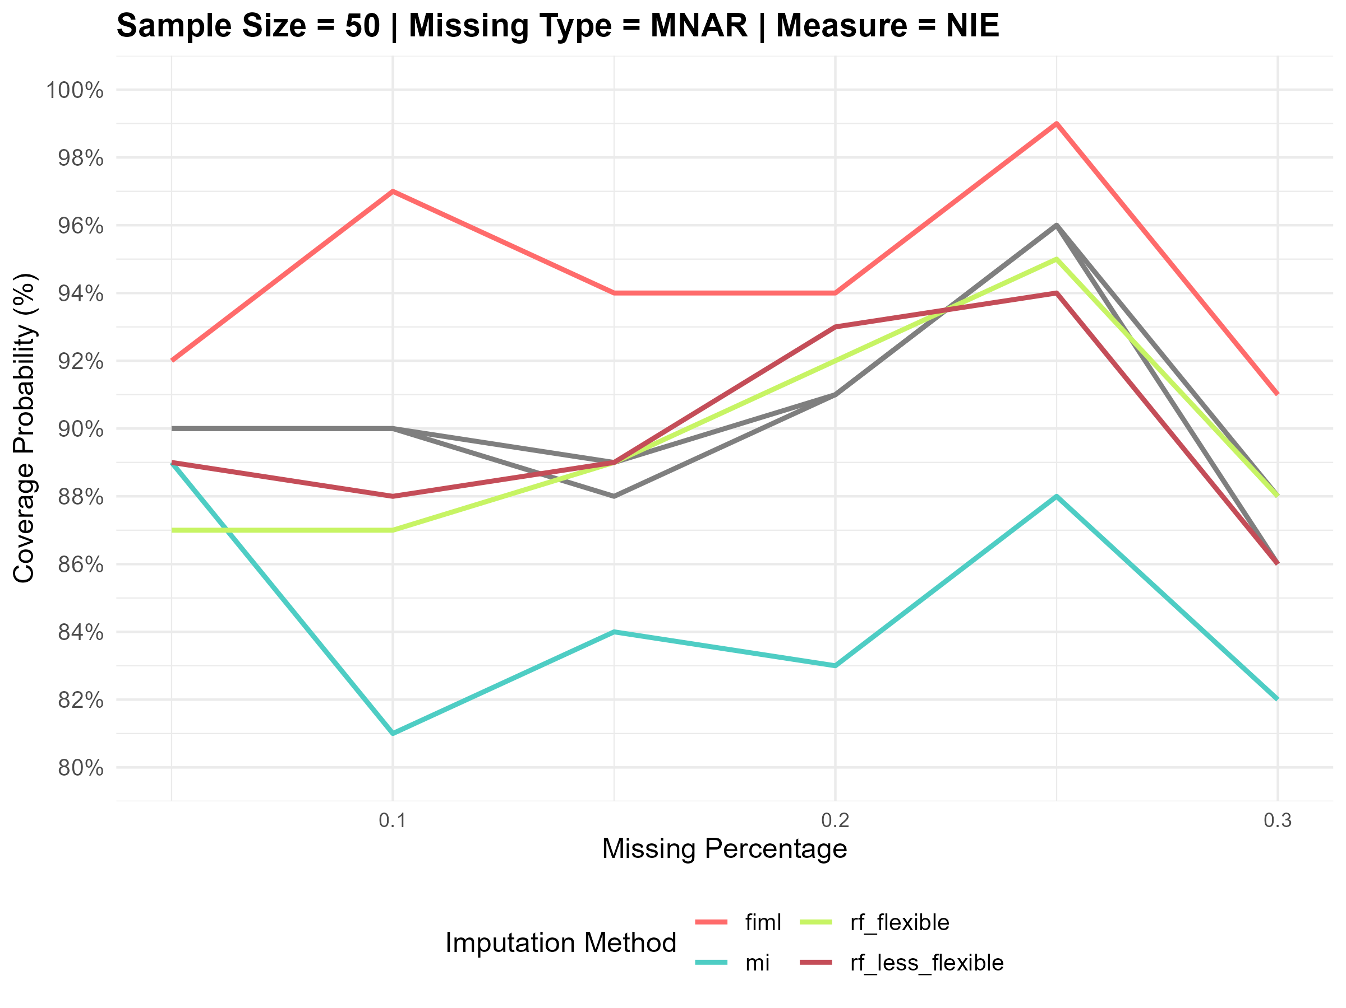
Plots for Coverage probabilities (NIE) under Scenario 2

Slide 12
Summary
In the cases like Scenario 1 with a simple DAG structure, if the sample size is large, the relative biases are pretty much unbiased and the coverage probabilities are mostly at the nominal levels (around 90-95%) in the case of MCAR.
However in the MNAR case, the relative bias slightly increases with the increase in the missing percentage. But the estimates are pretty much robust given the large sample size. The coverage probabilities are below the nominal level in this case because of the complexity of MNAR mechanism. MI and FIML has better coverage probabilities at higher missing percentages.
For the low sample size and MCAR, the bias tends to be slightly higher especially with smaller missing percentages, due to the limited sample size. FIML and MI has slightly lower bias than compared to Non parametric methods at higher missing percentages. However, MI and non parametric methods have slightly better coverage probabilities than compared to FIML.
For the low sample and MNAR, flexible methods show better performance than compared to FIML and MI both with respect to relative bias and coverage probability as they do not impose any assumptions on missingness patterns
The relatives biases are much more pronounced in scenario 2 where the DAG is more complex. The biases in the NDE estimates are on lower end for lower missing percentages as L1 is not a direct confounder. However, the biases tend to increase for higher missing percentages as the outcome values based on imputed L1 values tend to be more biased at higher missing percentages and the coverage probabilities are not too wiggly for different cases as in the case of NIE
In the case of NIE, which is more relevant, the biases tends to be extremely high for low sample setting when compared to high sample setting. In the high sample setting, MI and FIML tend to outperform Non parametric methods especially for higher missing% which might be the case of overfitting and less reliable estimates and higher bias. The coverage probabilities for FIML are pretty high for both MCAR and MNAR in this setting.
However in the low sample setting and MCAR, the bias for FIML and MI is predominantly high at low missing percentages as the missing percentage increases the trends are pretty much cluttered for all the methods, in case of MNAR, the bias increases in a steep manner with increase in missing % for all the methods

Slide 13
Conclusion and Way Forward
This study shows that no method is superior to any other methods. It all depends on the assumptions of the different methods.
Traditional methods like MI and FIML tends to outperform non parametric methods with high sample settings and MCAR/MNAR/MAR.
However, it is better to try Non parametric imputation methods particularly in the case of low sample settings and MNAR.
Our study is limited to linear relationships between the variables. However, in today’s scenario where most of the complex relationships and interactions involve high non linearity, several studies have shown that non parametric methods are a good choice to explore particularly when the data is not normally distributed and it involves categorical predictors.
An immediate extension to this study is to simulate the data using non linear relationships between the variables and fit non parametric models like GAMs/ Neural Networks to the outcome regression model.
It is expected that the non parametric imputation methods would outperform traditional techniques in such a scenario.

Slide 14
THANK YOU

